Slide 1
SOFTWARE AND COMPUTING
The brains . . .

Slide 2












TRENDS IN MACHINE VISION
Sensor
Stack
Machine Vision Stack
Actuators
Trend #1: HD Map Engine moves from the navigation stack to the machine vision stack
Trend #2: Little or no reliance on CNNs for safety applications
Vector-based HD Map Engine
Polyline-based HD Map Engine

Slide 3
SENSOR STACK COMPARISONS
Motion
This transformation has occurred in the industry with the adoption of mobile mapping techniques and sensors for real-time AV’s.
Real-time AV Sensing
Distance
Mobile
Mapping
For 2020-2023, this transformation will drive safety for LKS.
LKS Sensing
Radiance
Luminance

Slide 4
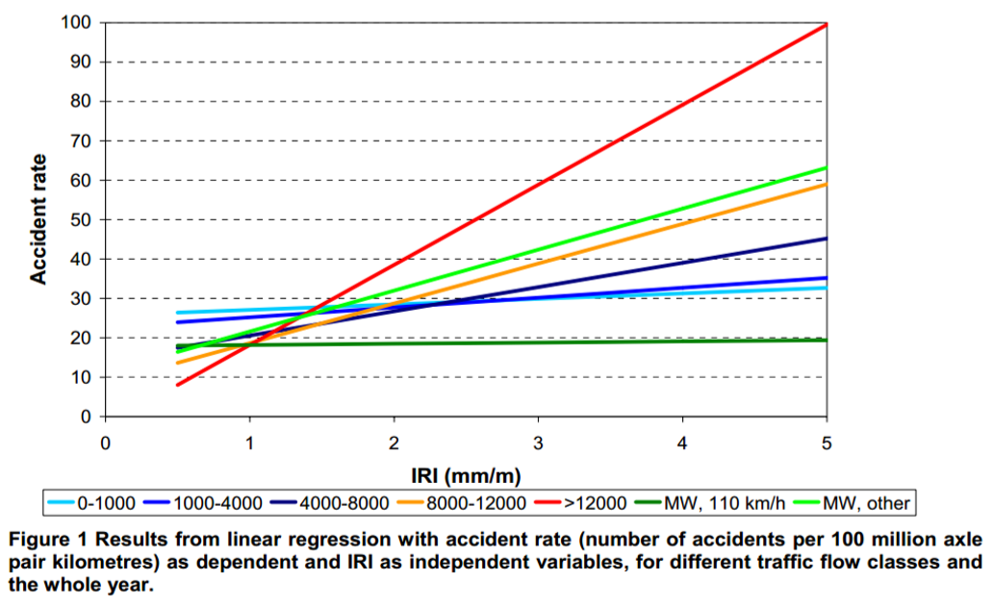
SAFETY and ROUGHNESS INDEX
“The effect of roughness on accidents is the same on all accident types (property damage, minor injury, medical treatment, hospitalization, fatality).”
“However, an increased IRI had the greatest effect on single-vehicle accidents, compared to multi-vehicle accidents” (Ihs 2004, p.4).
Inclusion of RI in vHAD ™ allows the vHAD ™ map engine to select routes based on predicted safety level
Notes:
Find the references for this
Smoother roads are safer roads

Slide 5



SAFETY and COEFFICIENT OF FRICTION
Stopping Distance
Lateral Slip
Wet Roadways
Icy Roadways
Two scenarios – μ_{F} in vHAD ™ and dynamic determination of μ_{F}
Notes:
- Need to find a reference for this slide and a good picture

Slide 6
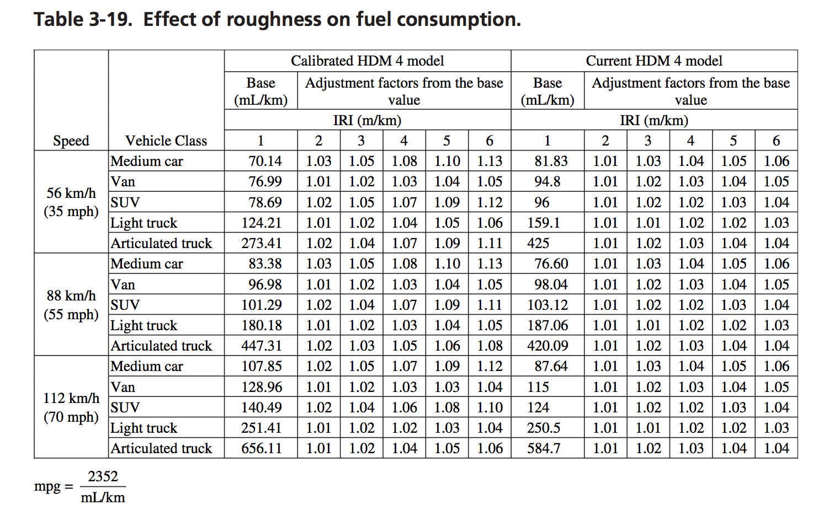
FUEL/EV EFFICIENCY AND ROUGHNESS INDEX
FUEL EFFICIENCY
RI
Bennet, C. R., and Greenwood, I. D. (2003b). Volume 7: Modeling Road User and Environmental Effects in HDM-4, Version 3.0, International Study of Highway Development and Management Tools (ISOHDM), World Road Association (PIARC), ISBN 2-84060-103-6
Inclusion of RI in vHAD ™ allows the vHAD™ map engine to select routes based on predicted fuel consumption
Notes:
NCHRP report?
Take out table, label chart,

Slide 7
FUEL/EV EFFICIENCY and COEFFICIENT of FRICTION
Longitudinal slip = V_{s} /V_{L}= K/ V_{L}*μ_{F}
FUEL EFFICIENCY
FUEL EFFICIENCY
μ_{F}
μ_{F}
SPEED
SPEED
Having μ_{F} in vHAD ™ allows the vHAD ™ map engine to provide route guidance based on fuel/EV efficiency at posted speeds
Source: Pauwelussen, 2015

Slide 8
Roadway Safety Rating Determination for vHAD ™ Map Engine
Safety Rating
∑
=
f(L_{cam}) * f(R_{cam}) * f(L_{inf}) * f(R_{inf}) * f(topology) * f(uF) * f(RI) * f(environment) * f(construction-?)

Slide 9





Roadway Safety Rating Determination for vHAD ™ Map Engine
Infrastructure Luminance
Roughness Index
Camera Luminance
Topology
Construction
μ_{F}
Safety Rating
∑
=
Camera Radiance
Infrastructure Radiance
Coefficient of Friction
Environment
N
Each point on a roadway will have a safety rating.
The safety rating of a route is the average of the N safety rating points.

Slide 10
What you get with a Mandli solution . . .
Experience, it’s in our DNA
Single-pass mobile collection platform means safer, more efficient, no interuptions
ESRI is a commited partner with cloud services, LRS/Shapefiles, Client Feature layers
USPS
Map Provider for Iowa State ADS Grant
MDS opportunities
Cohesive Database solutions

Slide 11





INDUSTRY INVOLVEMENT

Slide 12
Pedestrian Signal Elements
Type | Ped Signal, Ped Push Button, Hawk, Rapid Flash Beacon
Facing Direction | N, NE, E, SE, S, SW, W, NW
Position | Latitude, Longitude, Altitude
Obstruction | Y/N
Horizontal Offset | Inch
Vertical Offset | Inch
Accessibility Condition | Good, Poor, Unknown*

Slide 13
Pedestrian Crossing Elements
Type | Unmarked, Standard, Continental, Solid, Dashed, Zebra, Ladder
Material | Asphalt, Concrete, Other
Position | Latitude, Longitude, Altitude
In-Street Signage | Y/N
Overhead Signage | Y/N
Rapid Flash Beacon | Y/N
Length | Foot
Accessibility Condition | Good, Poor, Unknown*

Slide 14
Sidewalk Data Elements
Type | Sidewalk, Shared Use Path
Material | Asphalt, Concrete, Other
Position | Latitude, Longitude, Altitude
Driveway Crossing | Y/N
Sidewalk Continues along Driveway | Y/N
Obstruction | Y/N
Vegetation Obstruction | Y/N
Path Obstruction | Y/N
Horizontal Obstruction | Y/N
Vertical Obstruction | Y/N
Temporary Obstruction | Y/N
Length | Foot
Accessibility Condition | Good, Poor, Unknown*

Slide 15
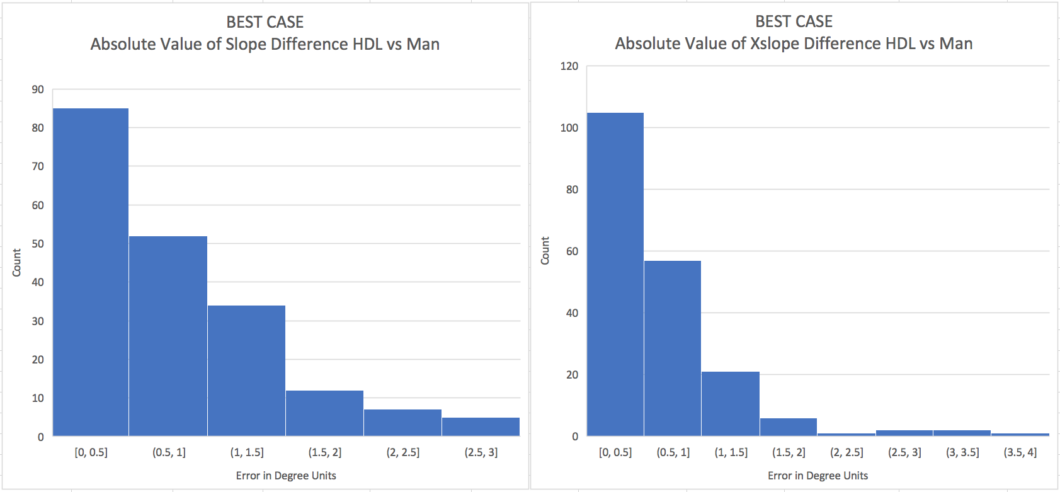

Slide 16


Slide 17
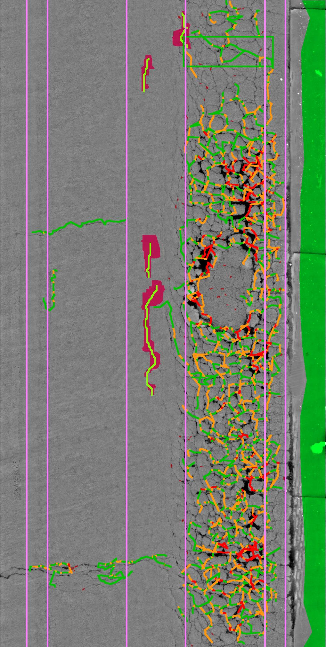
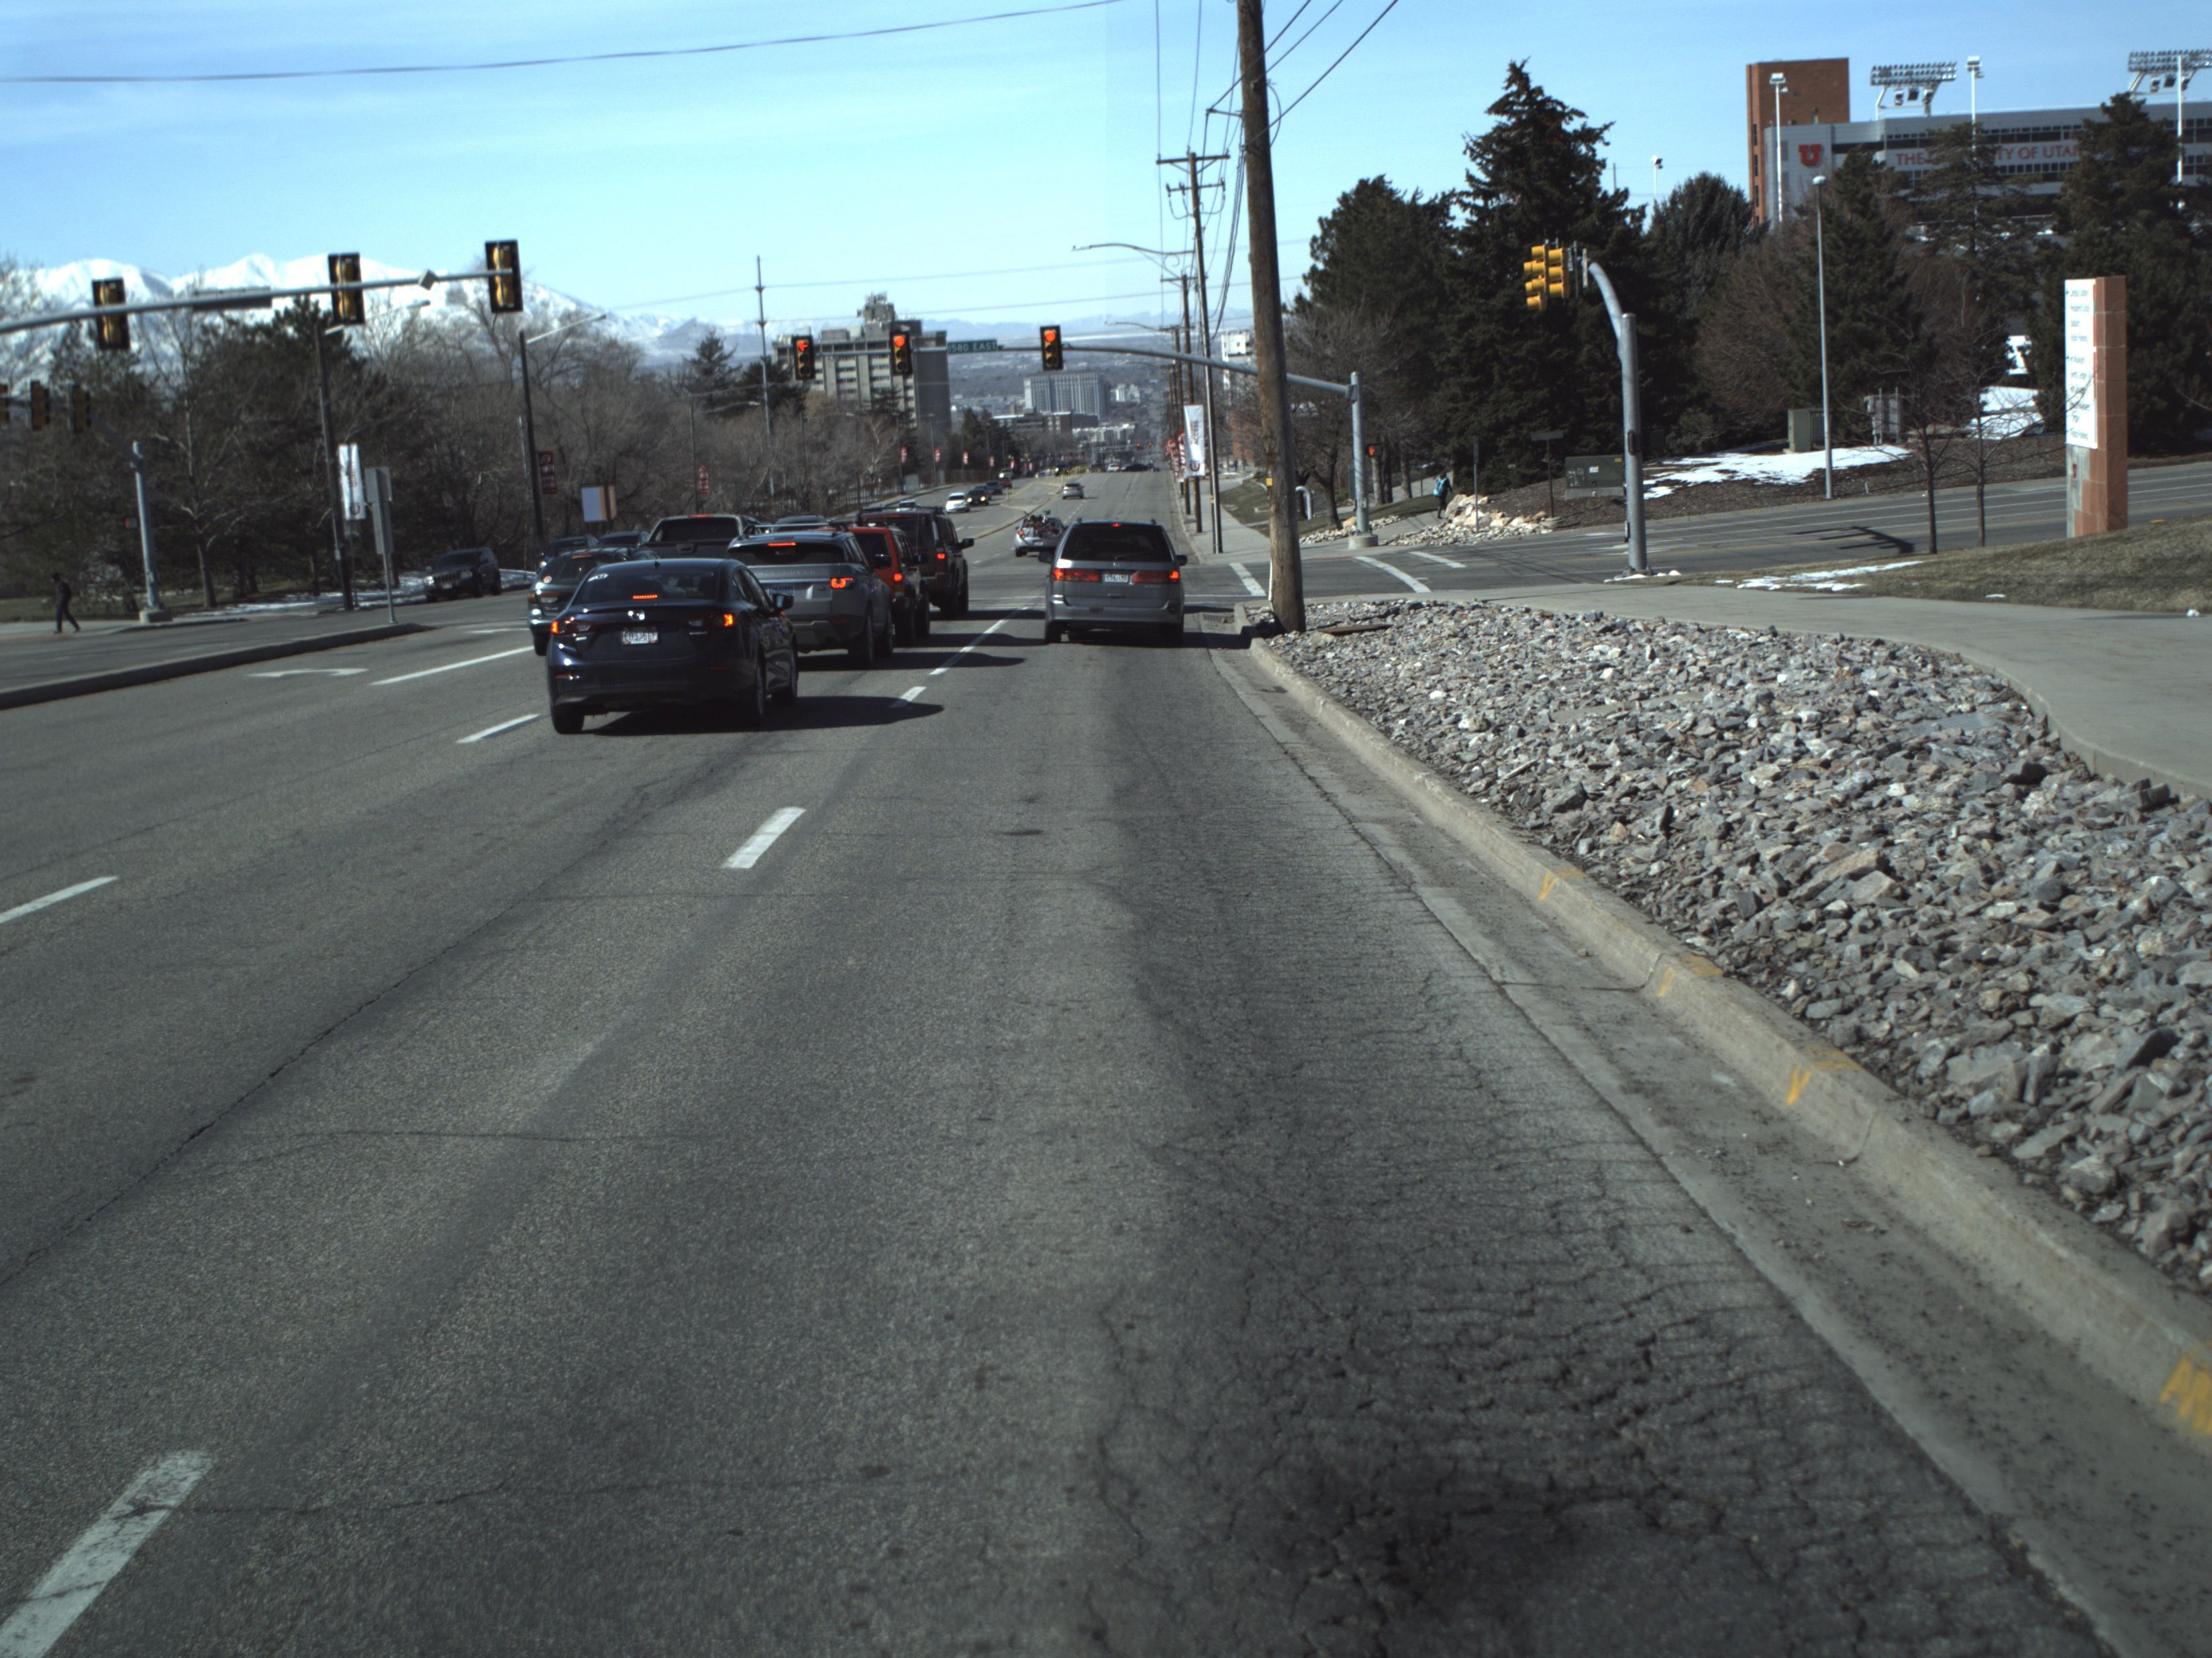
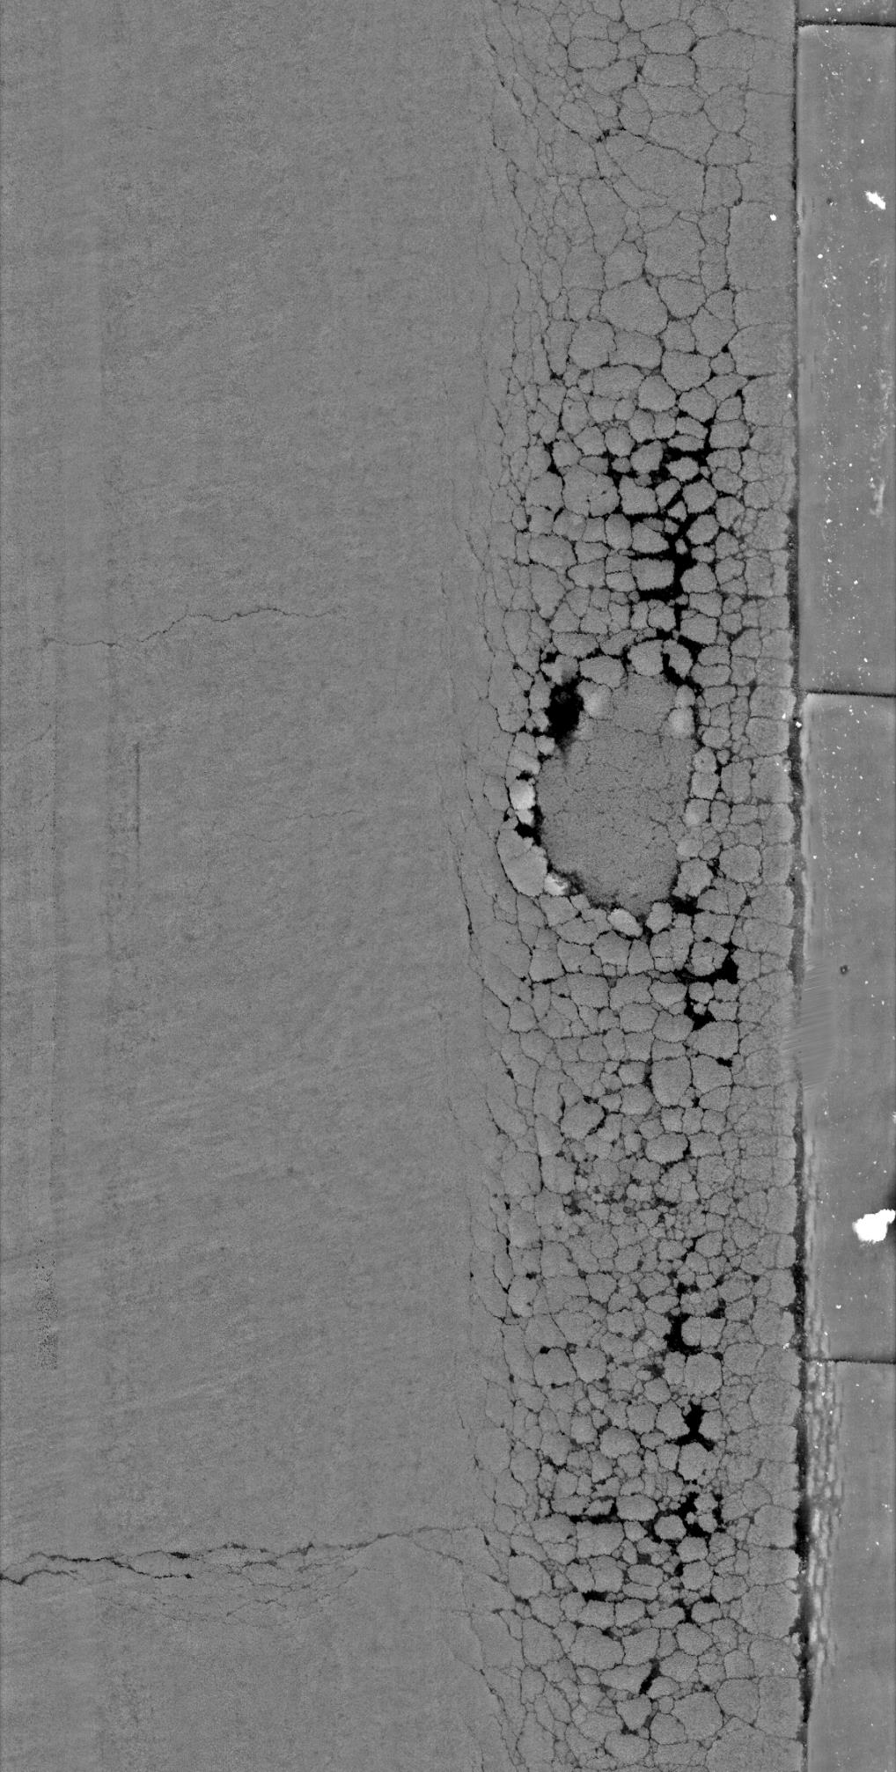
Alligator Cracking (RWP & LWP)

Slide 18
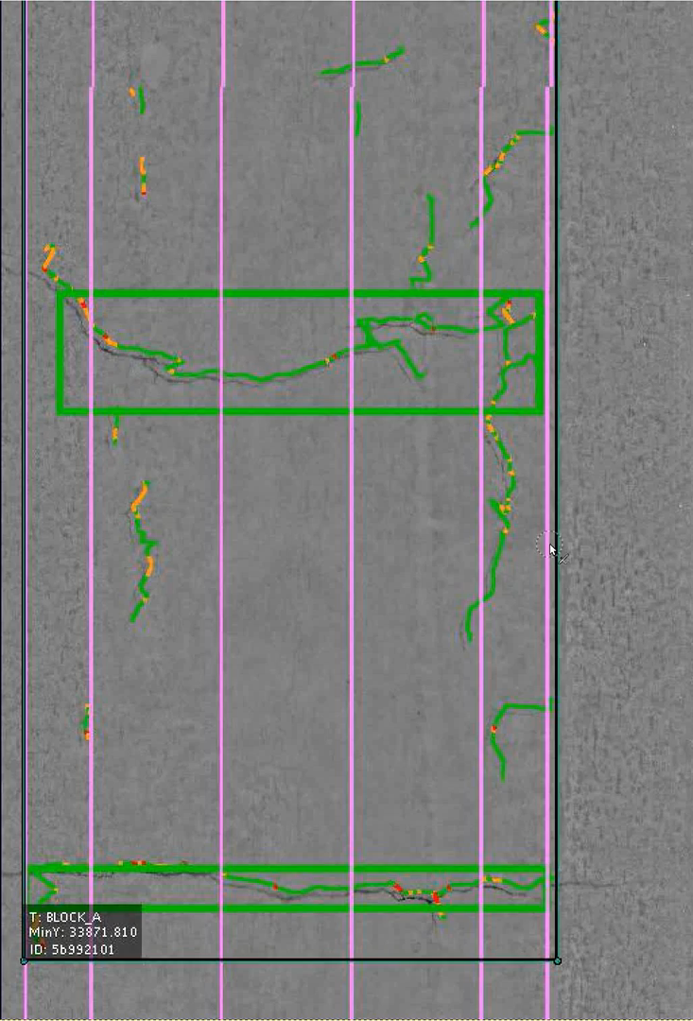
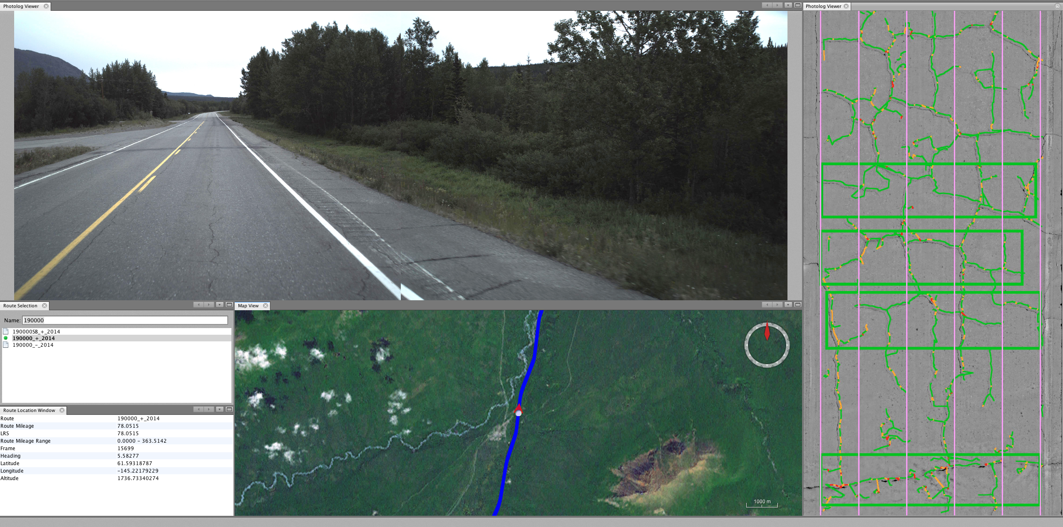
Block Cracking

Slide 19

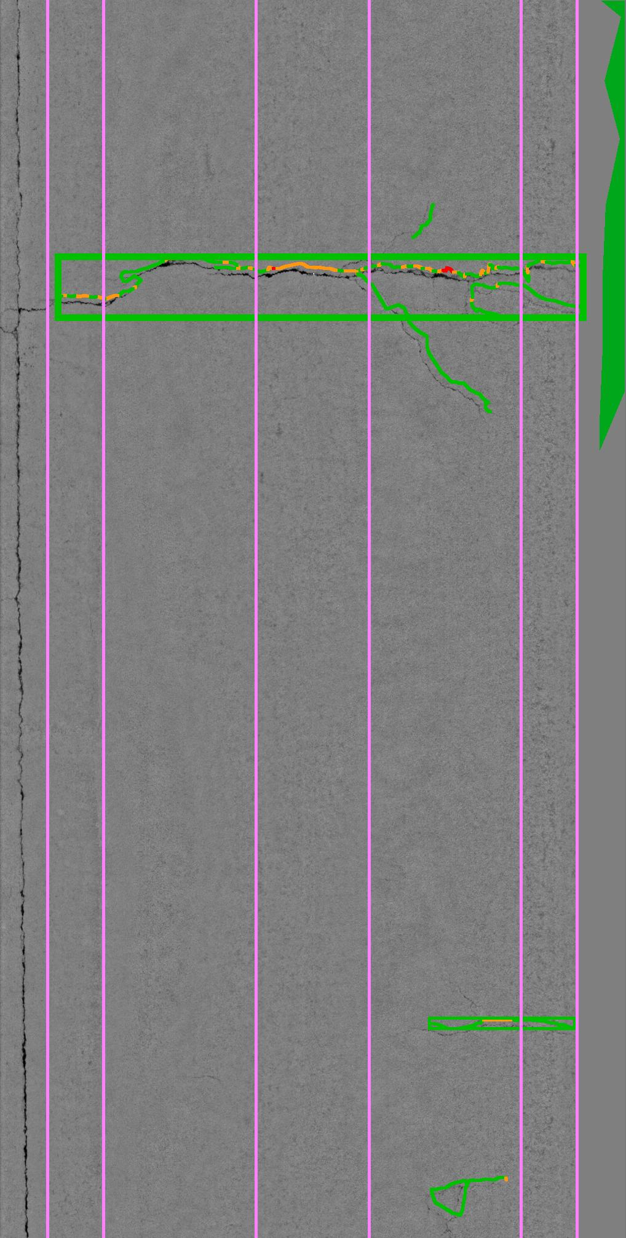
Transverse Crack (Regular)

Slide 20
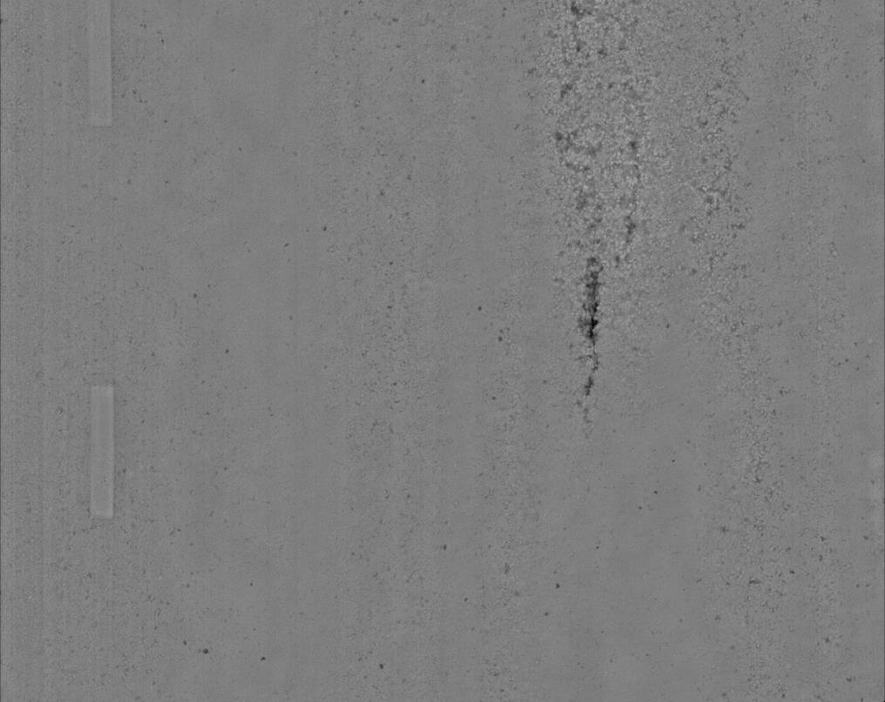
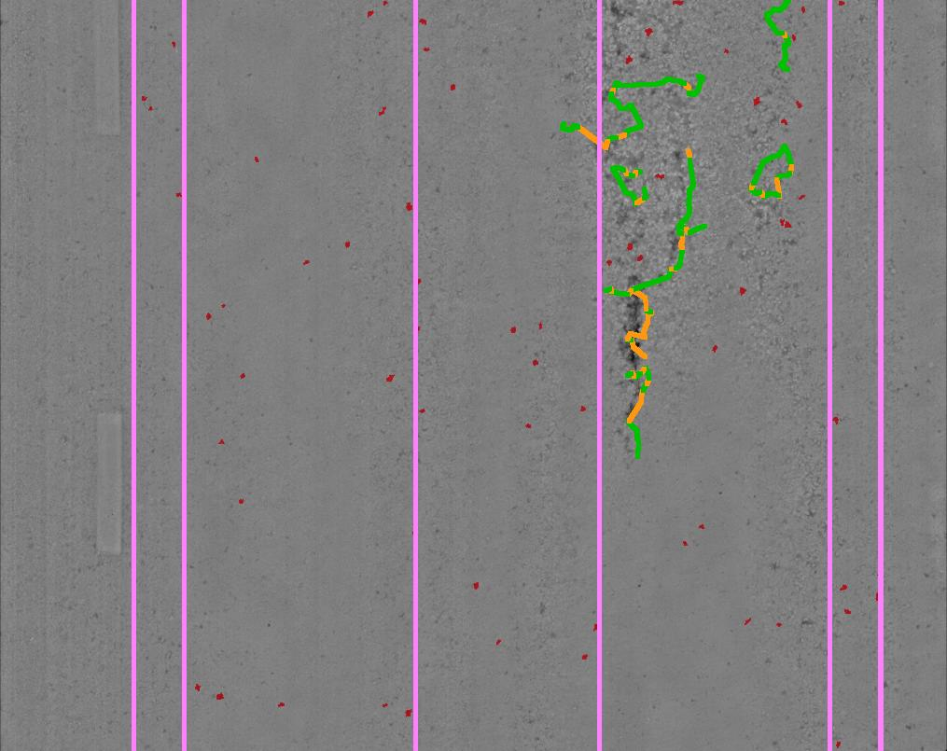
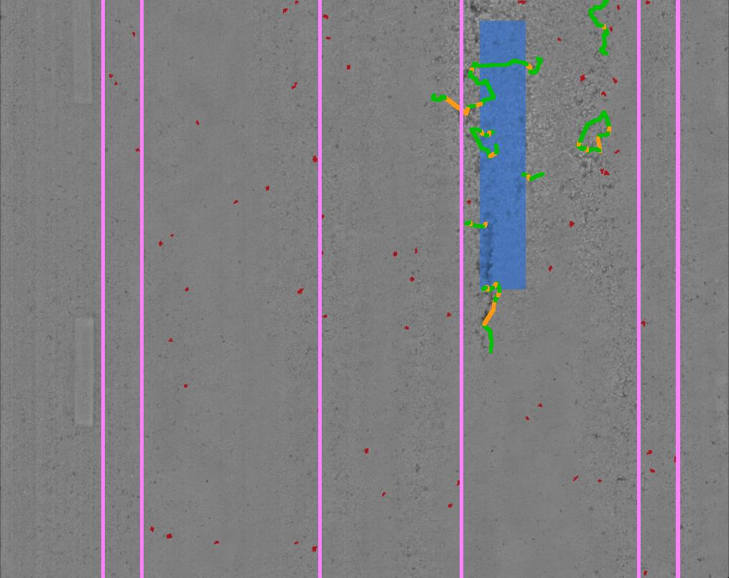
Raveling

Slide 21
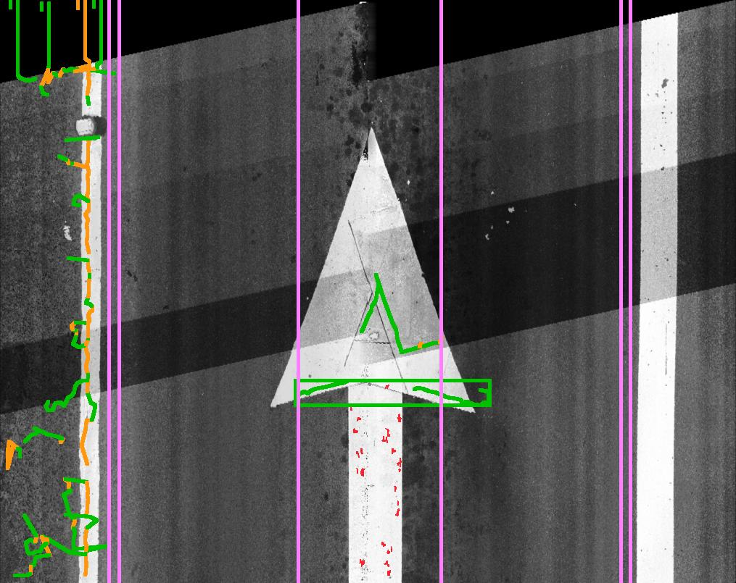
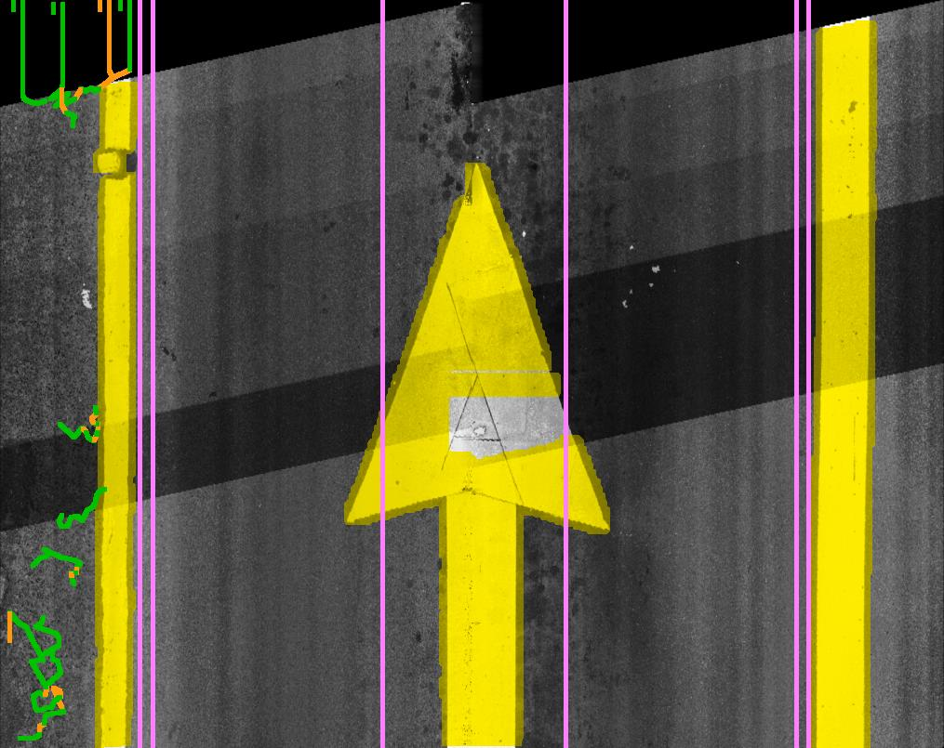
Contour Marking

Slide 22

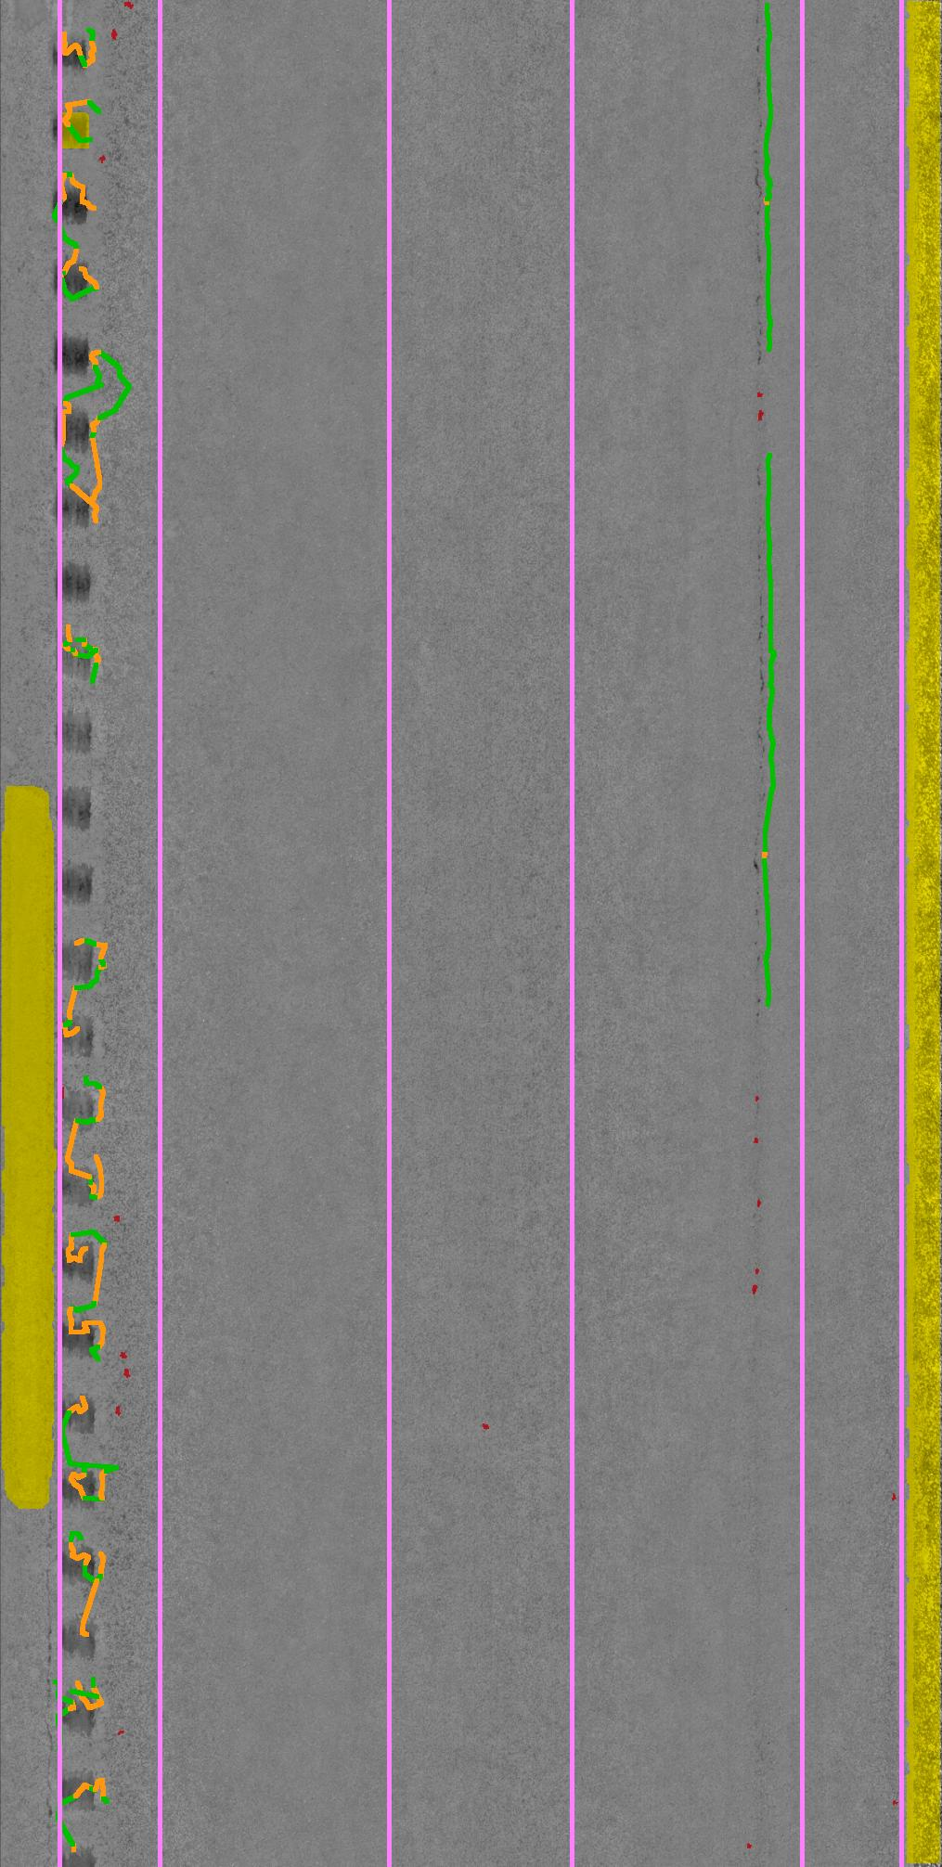

Rumble Strip Detection

Slide 23
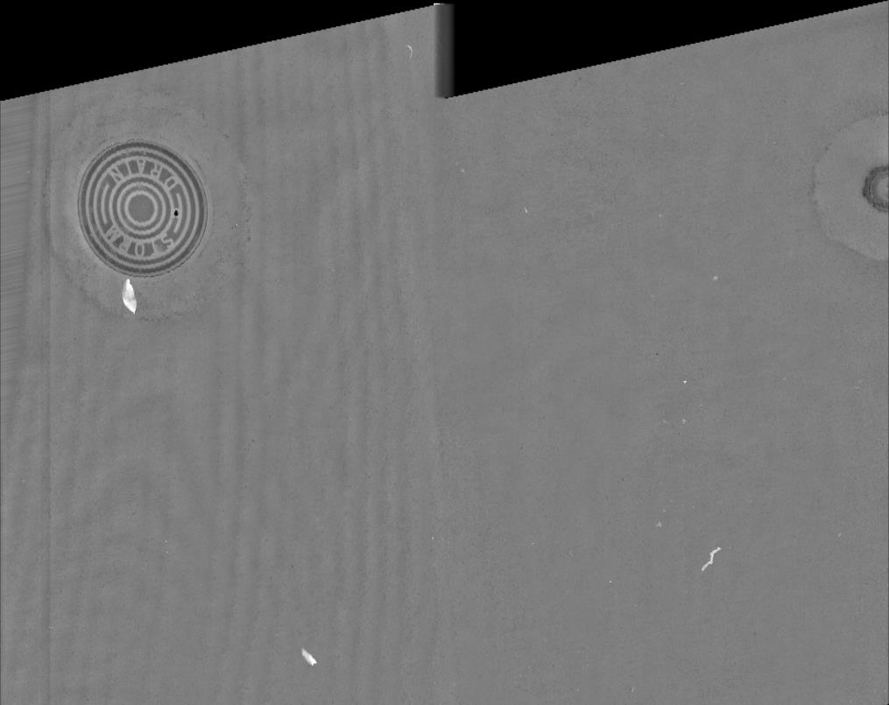
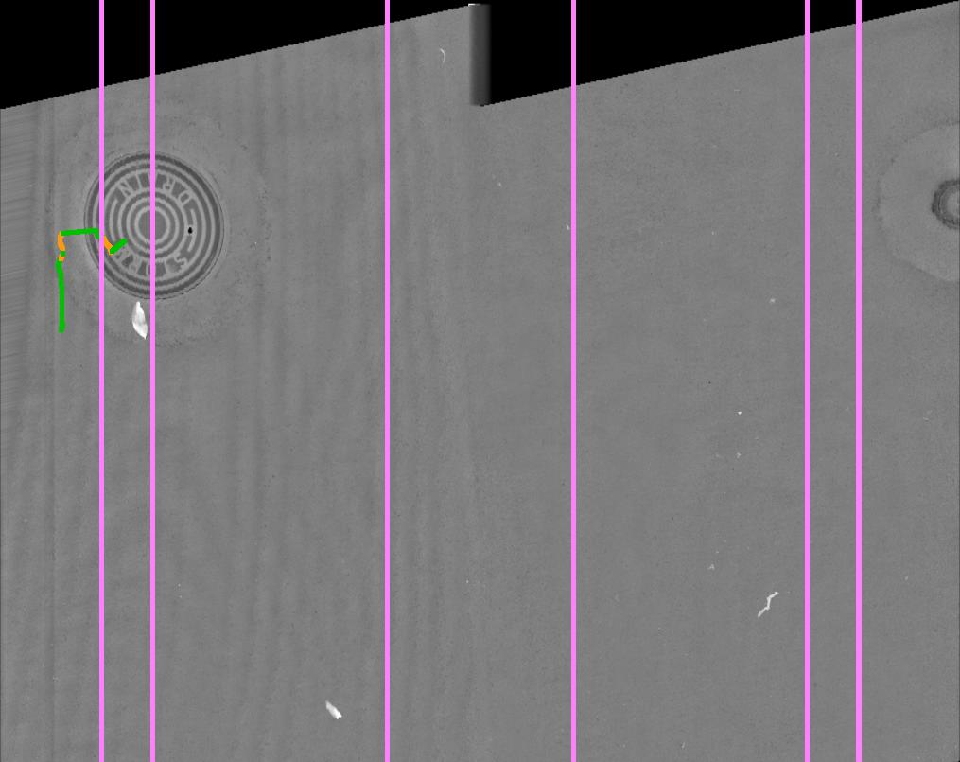
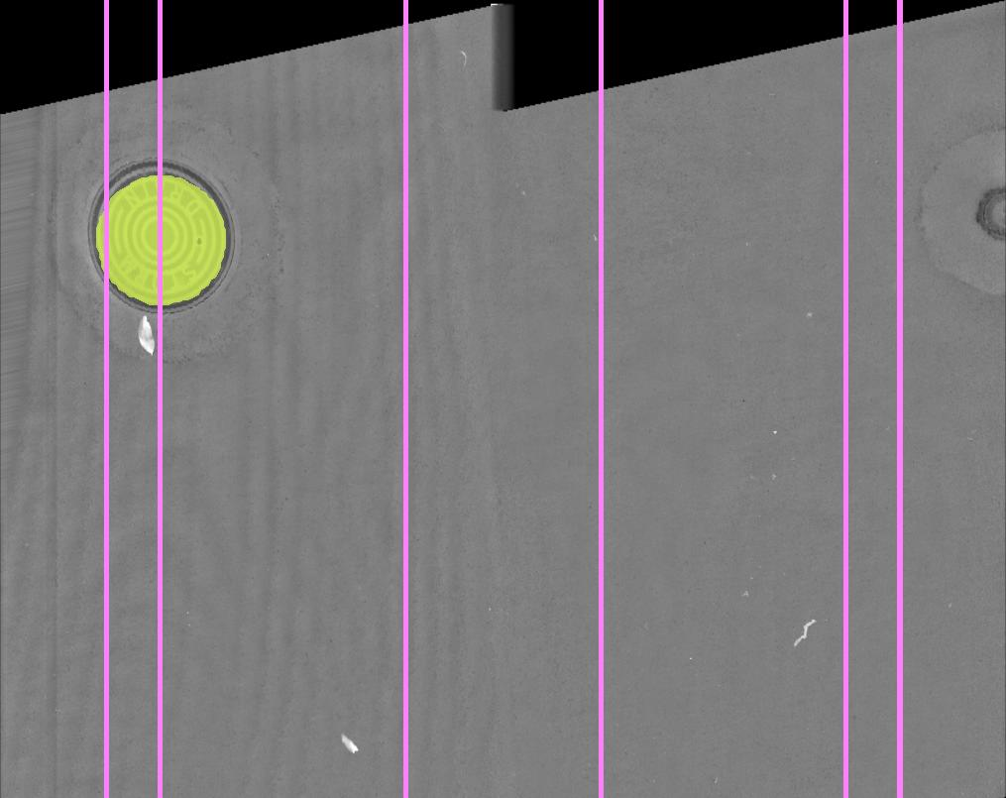
Man Made Object Detection

Slide 24
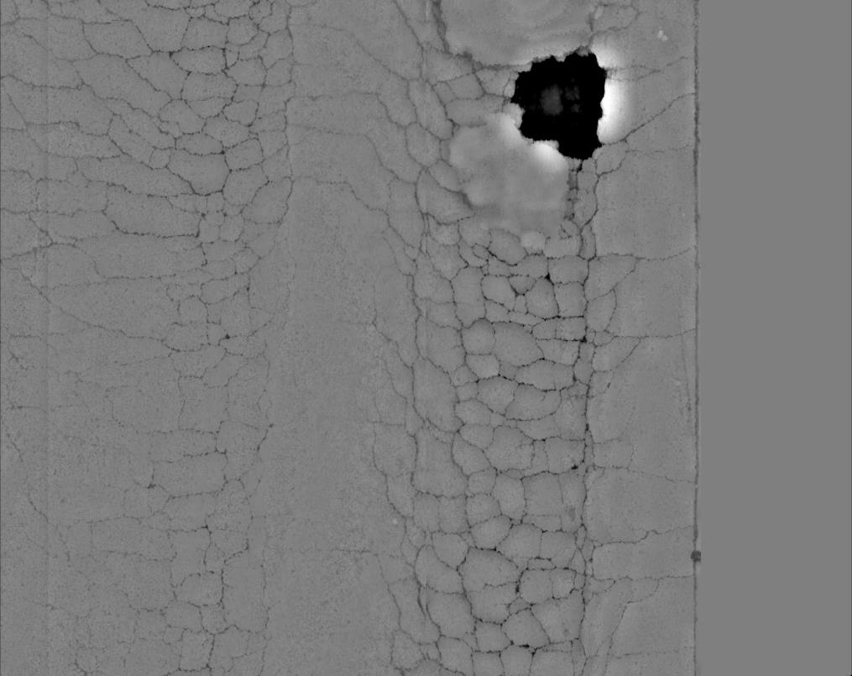
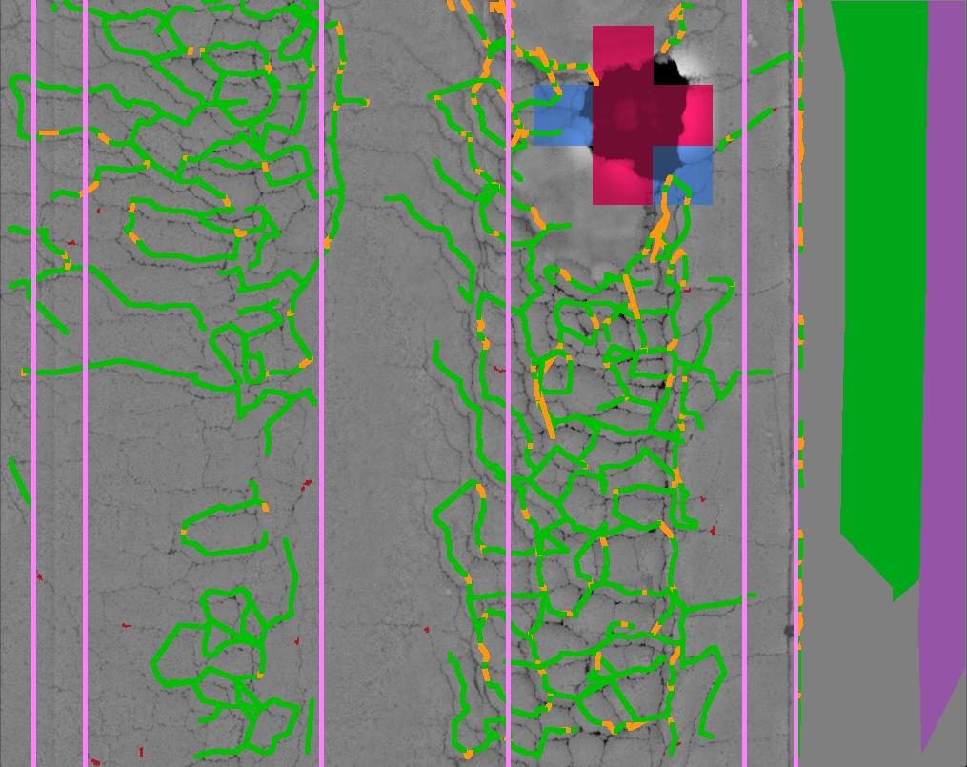
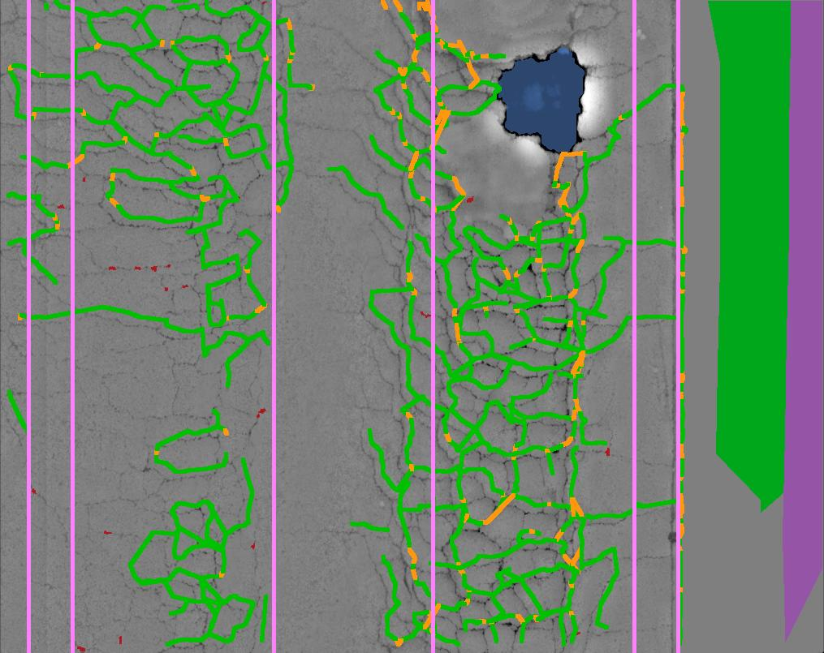
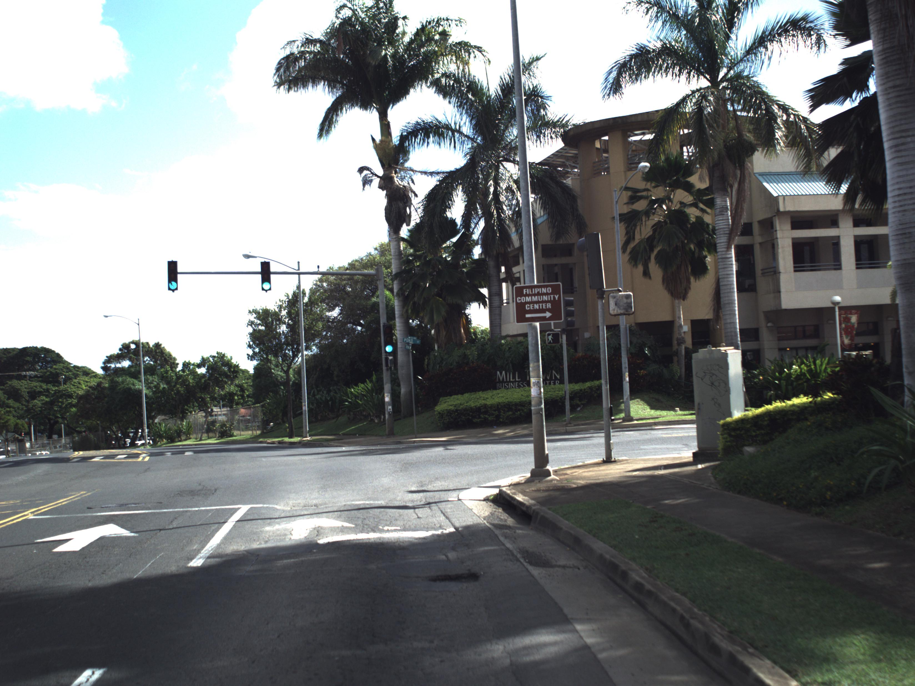
Potholes

Slide 25
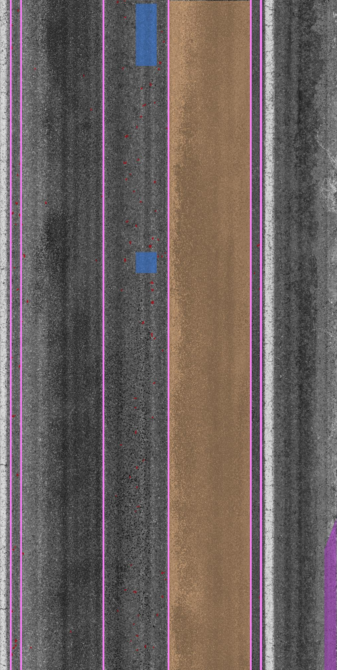
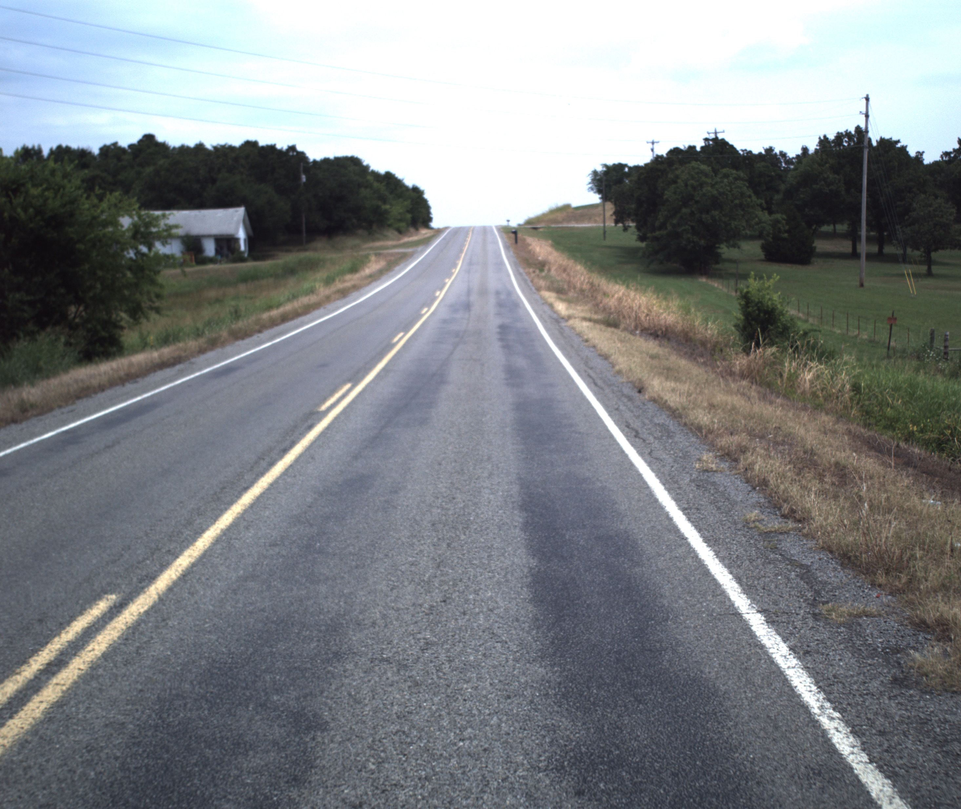

Bleeding

Slide 26
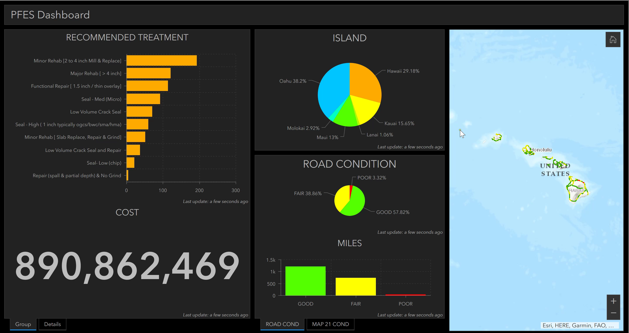
Plan For Every Section (PFES)

Slide 27
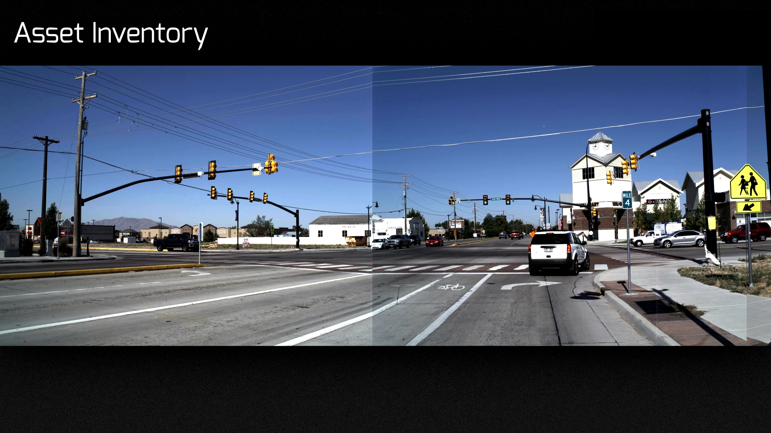

Slide 28
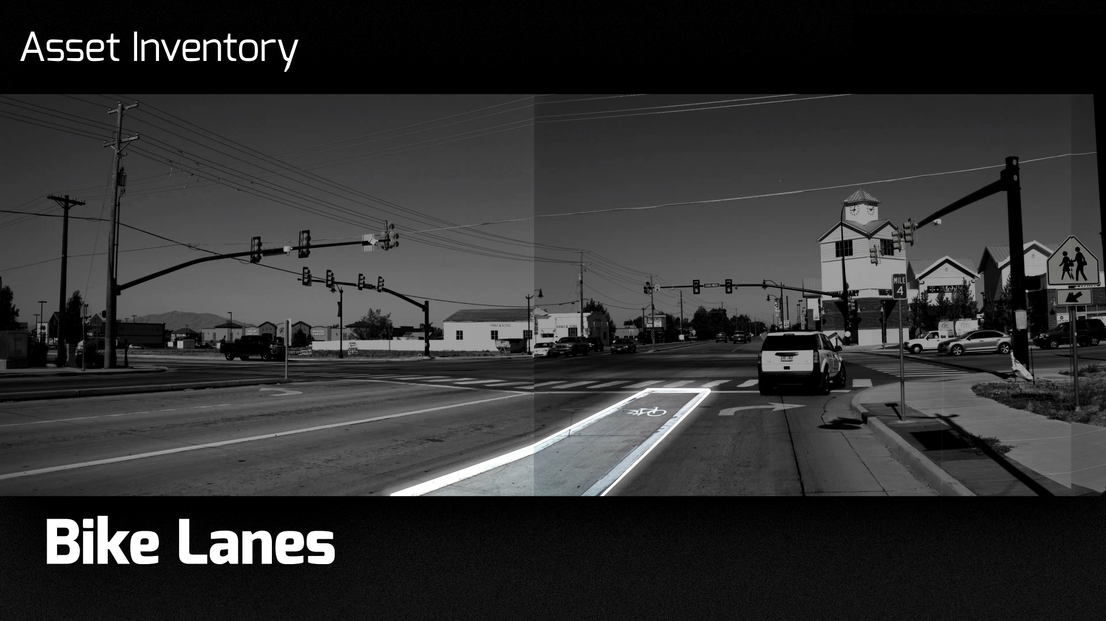

Slide 29
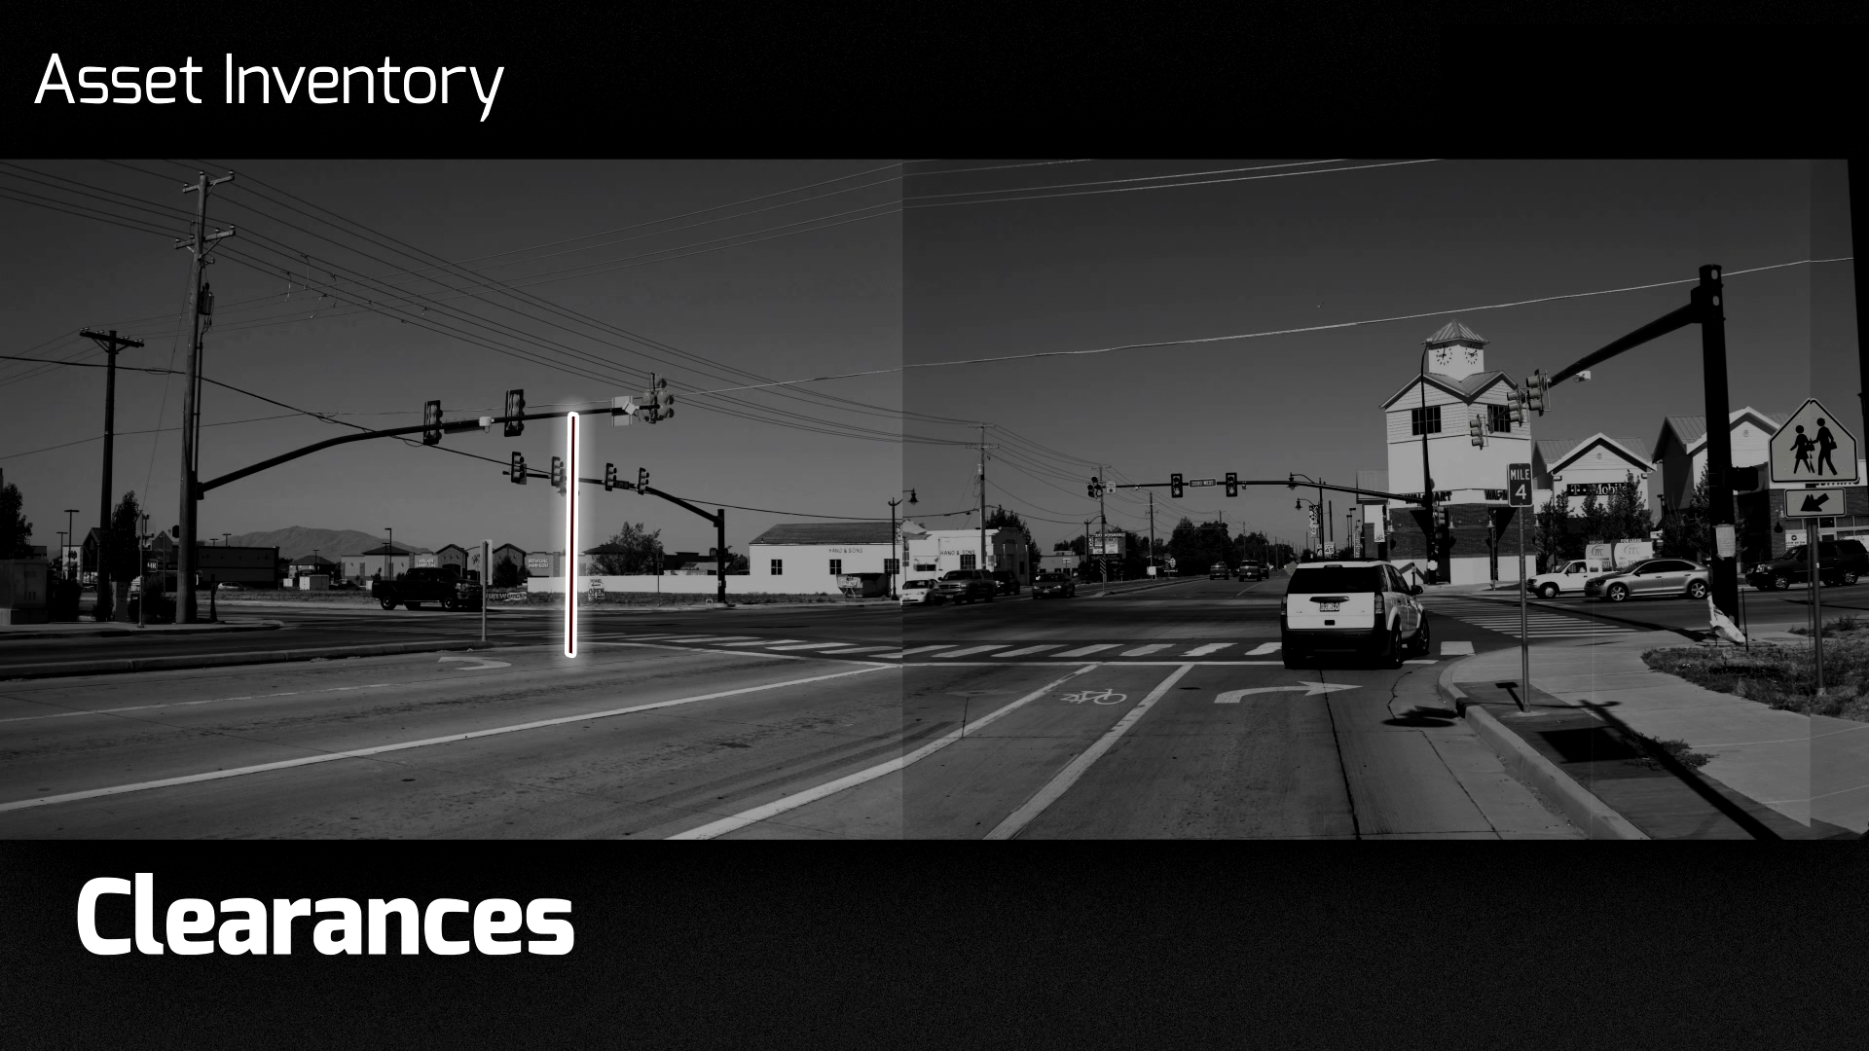

Slide 30
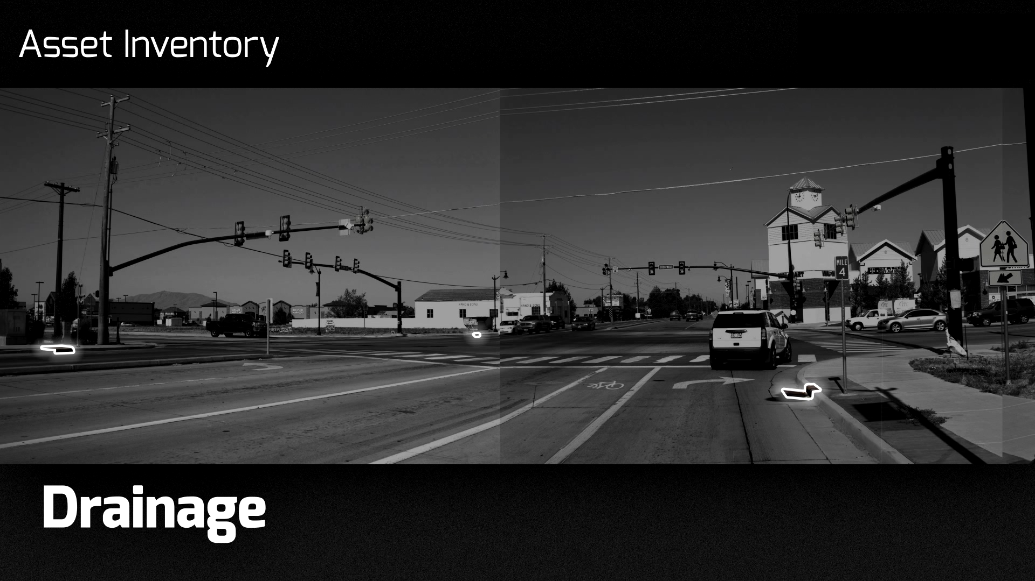

Slide 31
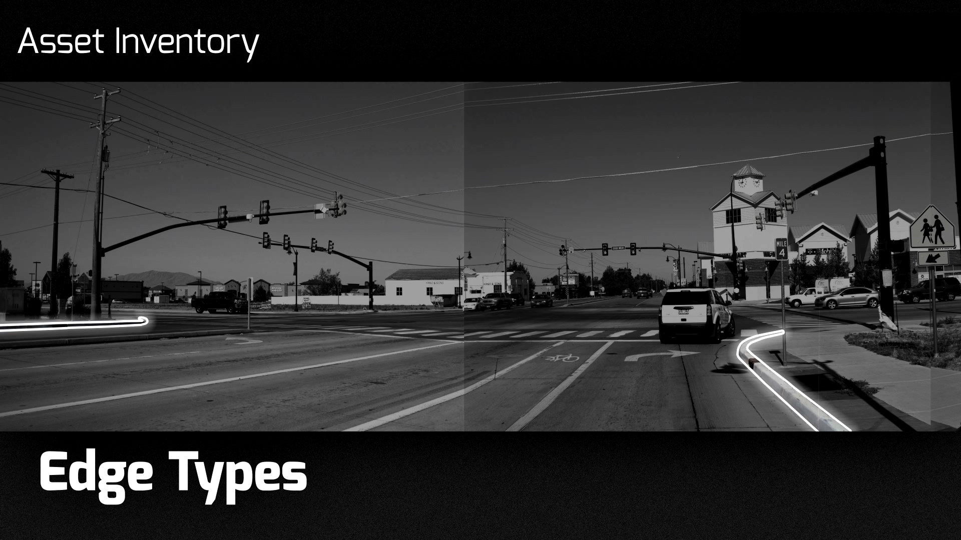

Slide 32
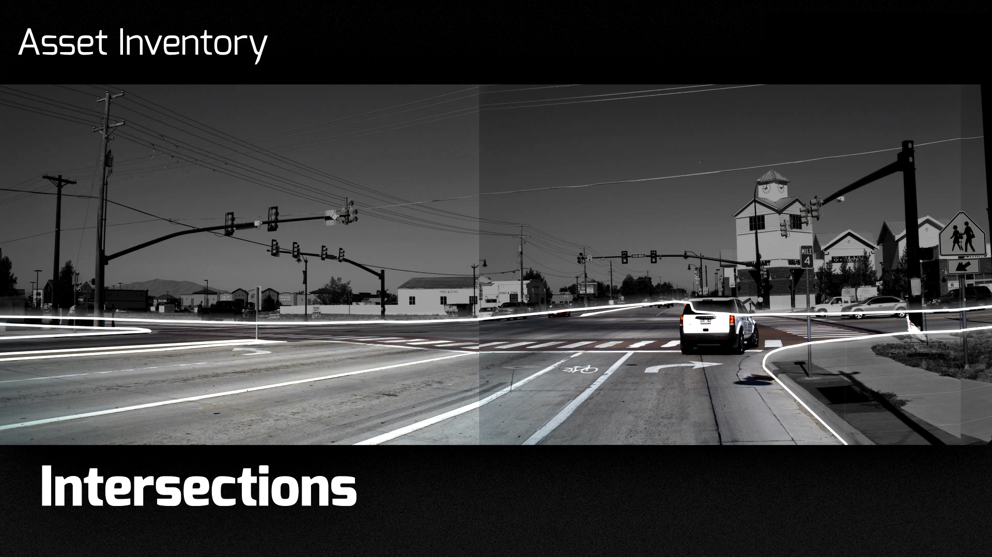

Slide 33
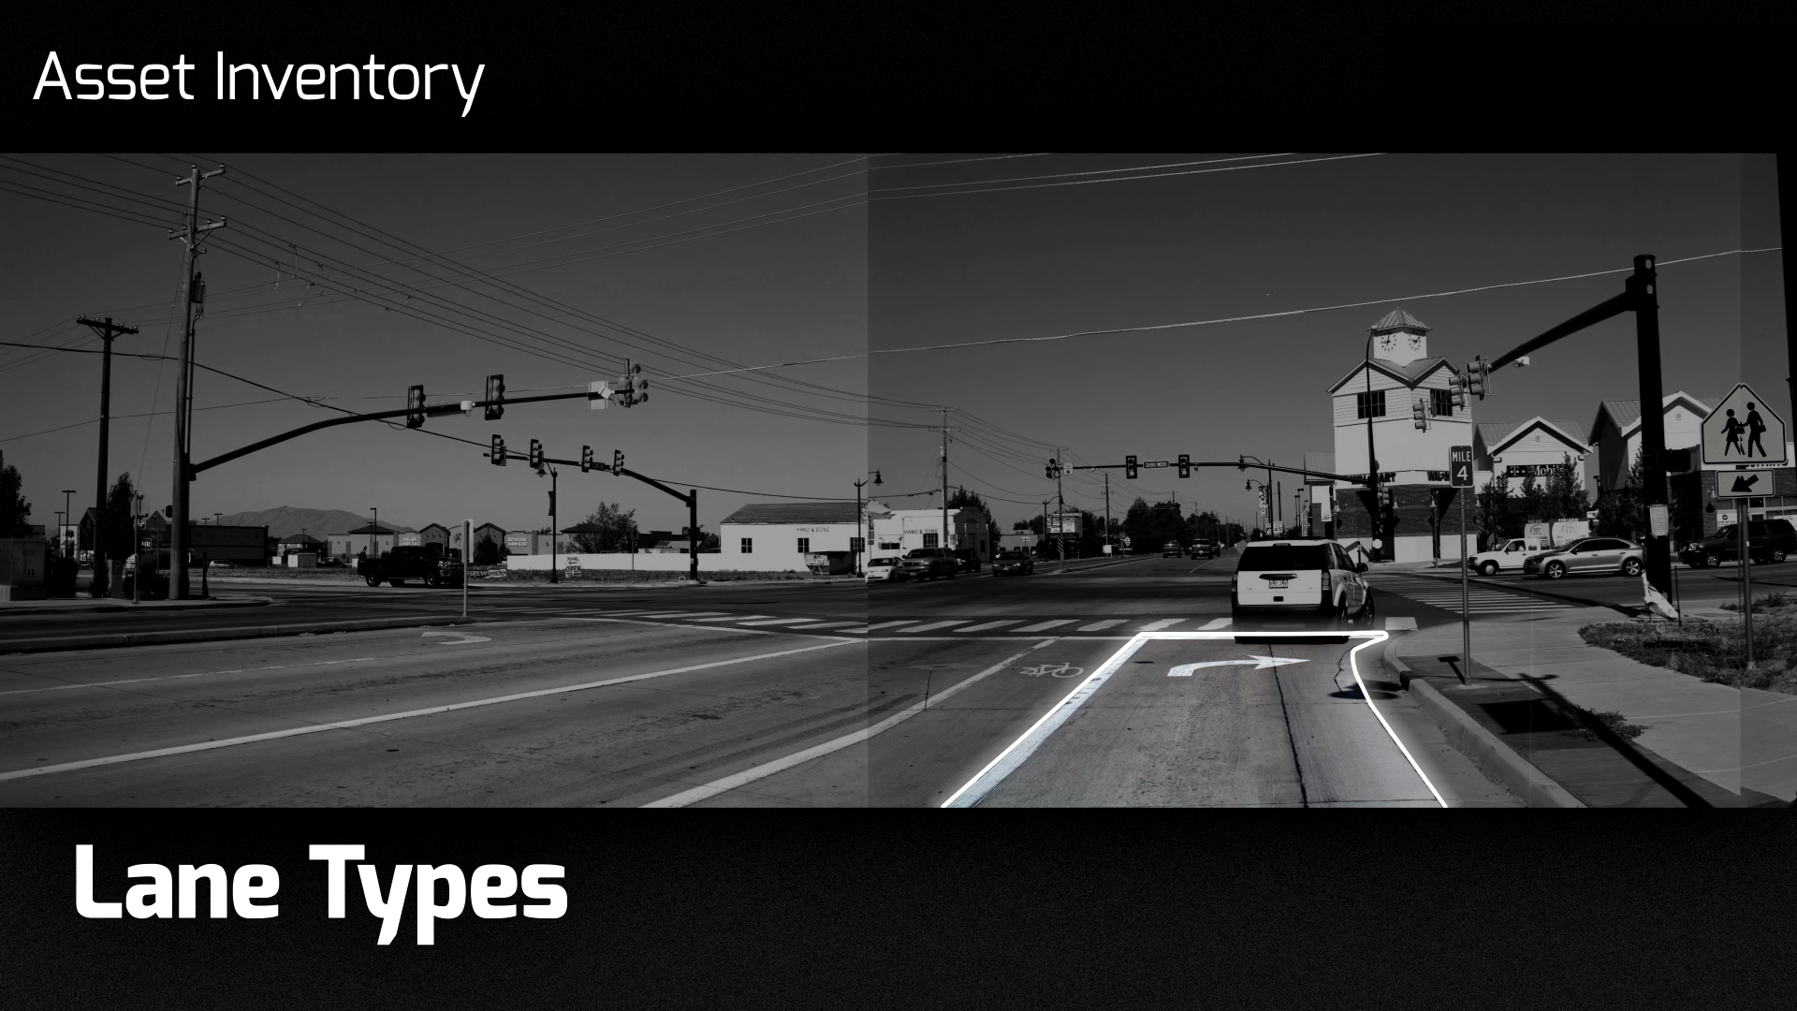

Slide 34
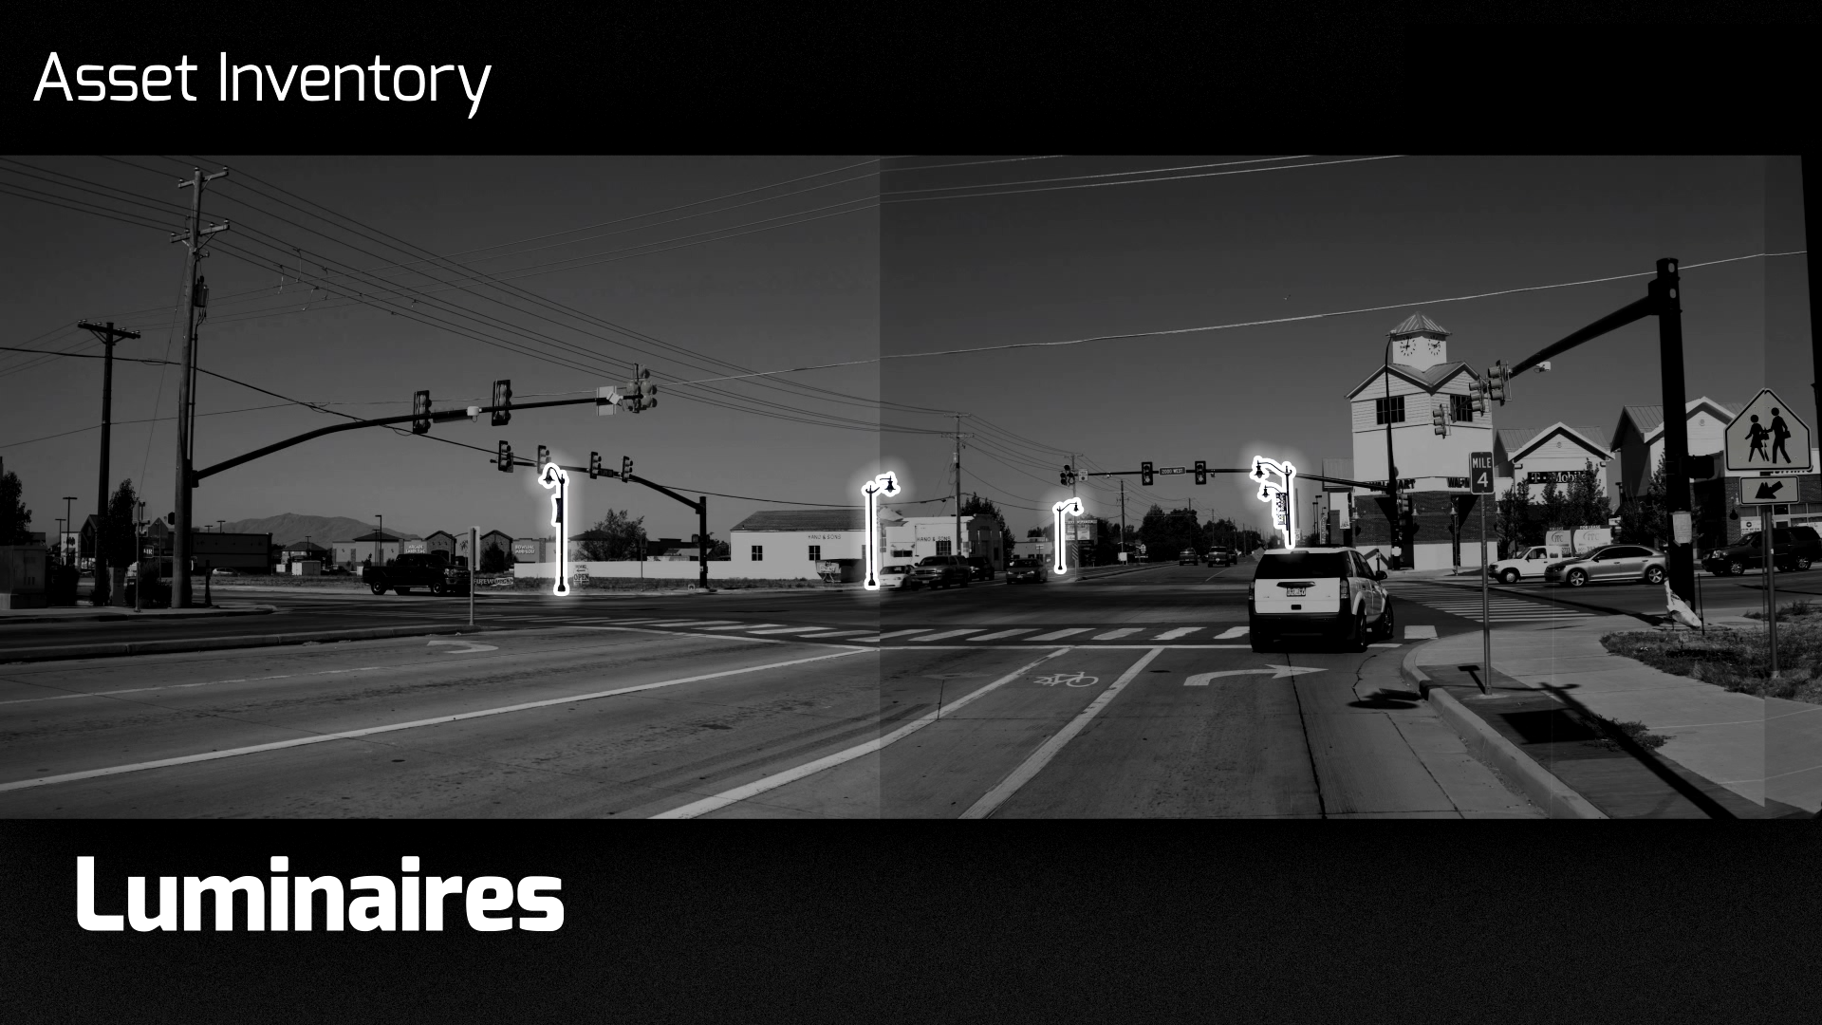

Slide 35
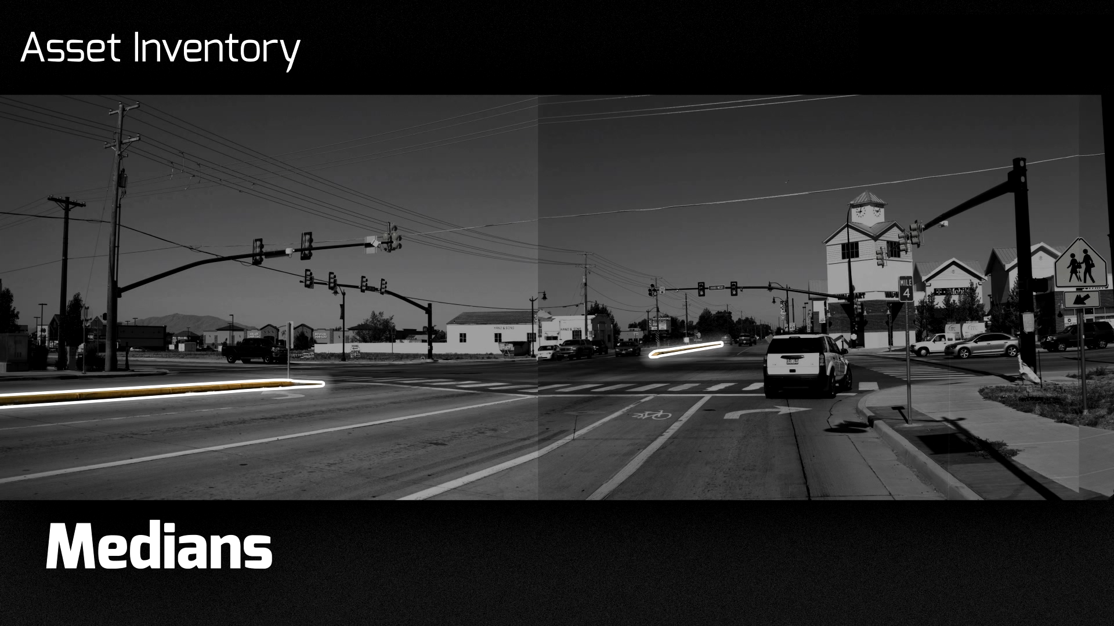

Slide 36
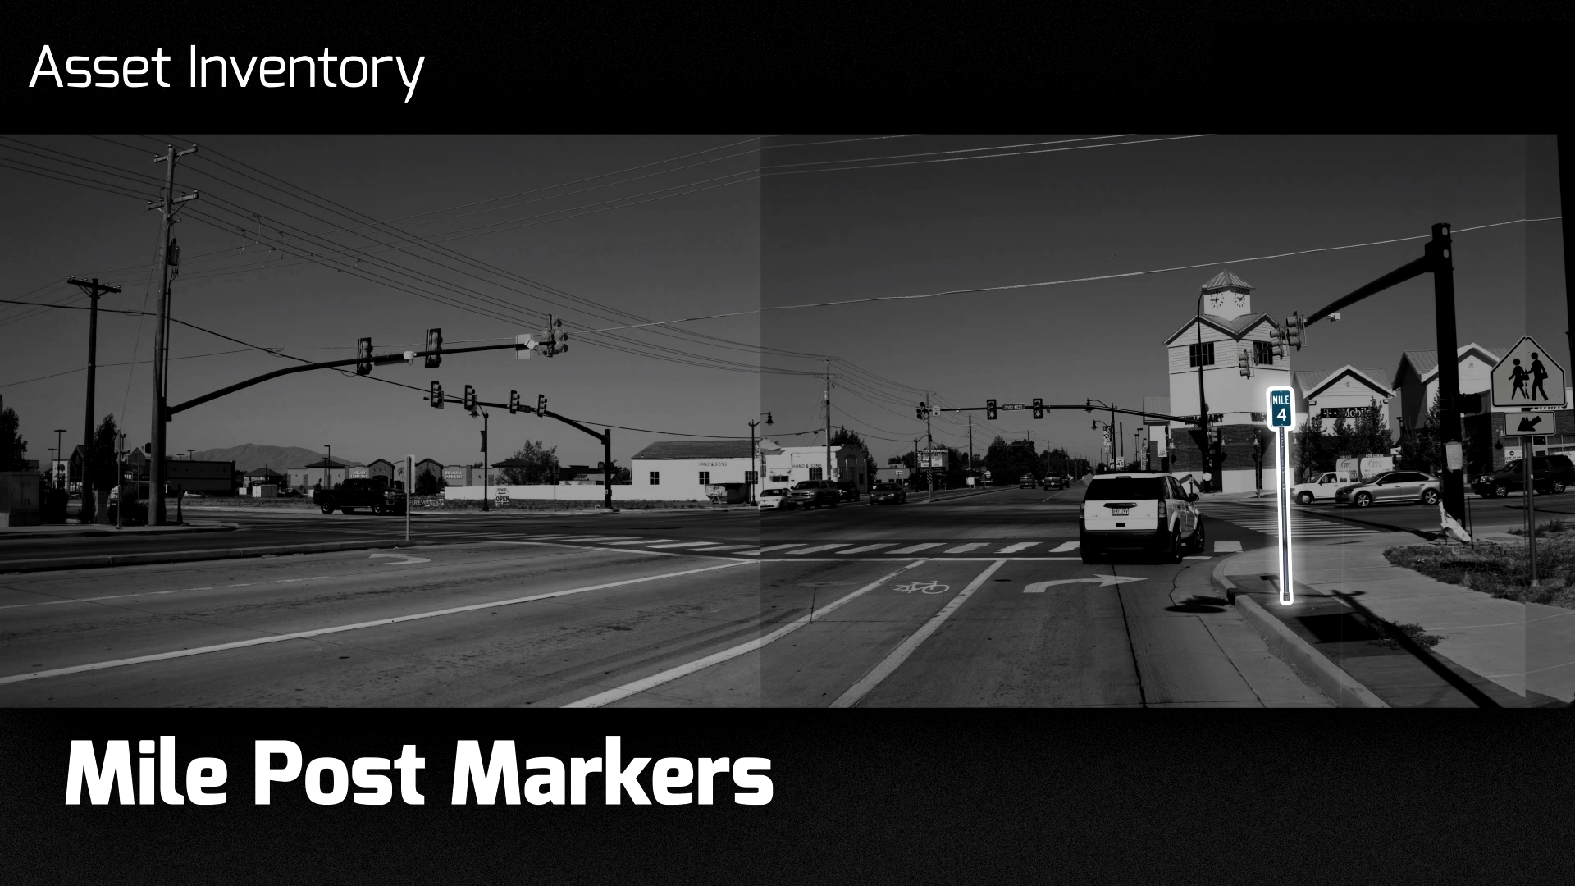

Slide 37
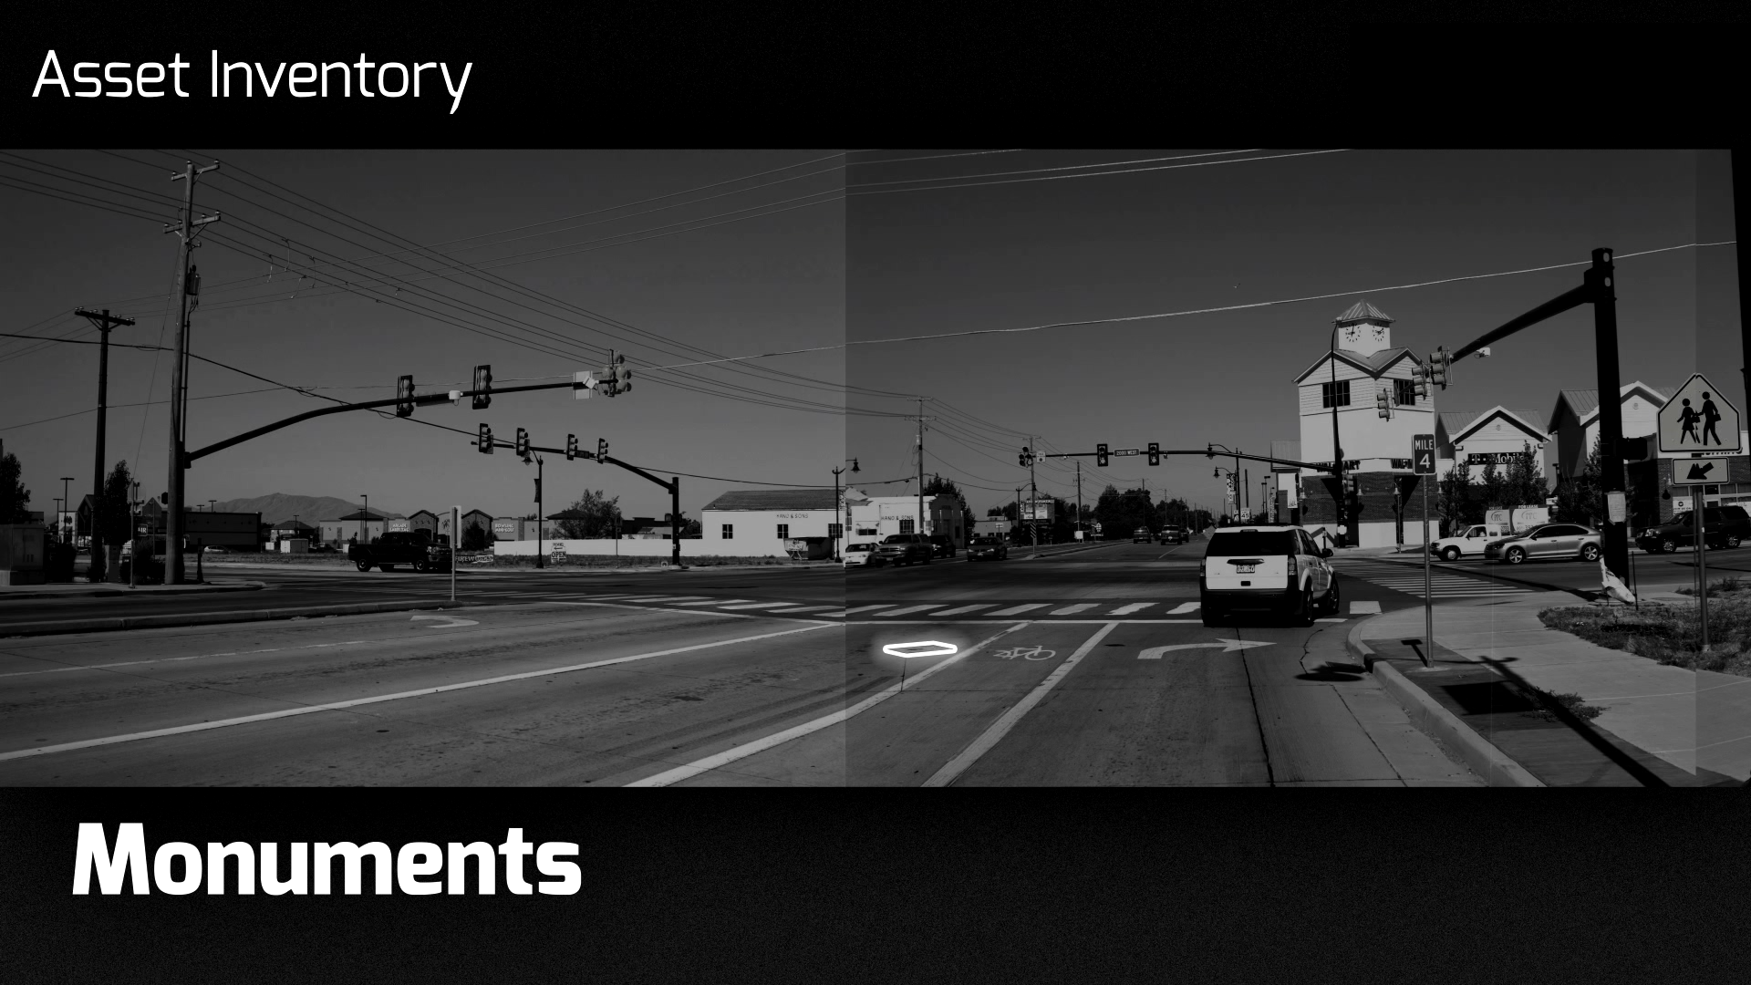

Slide 38
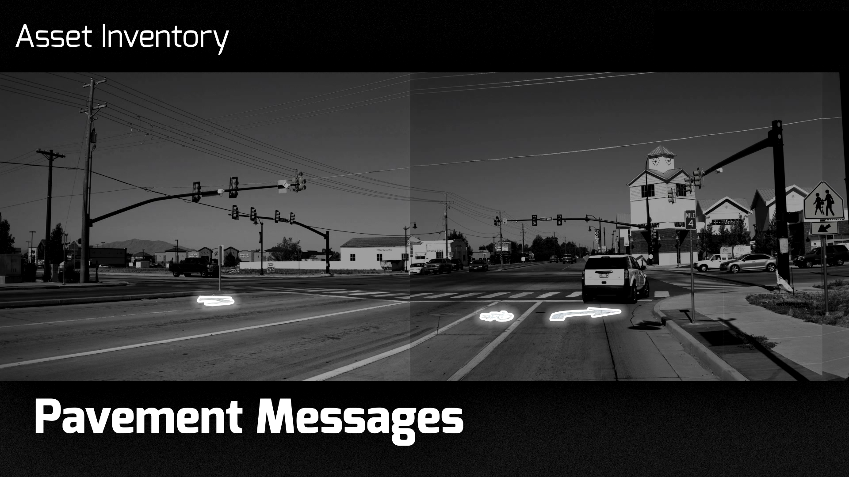

Slide 39
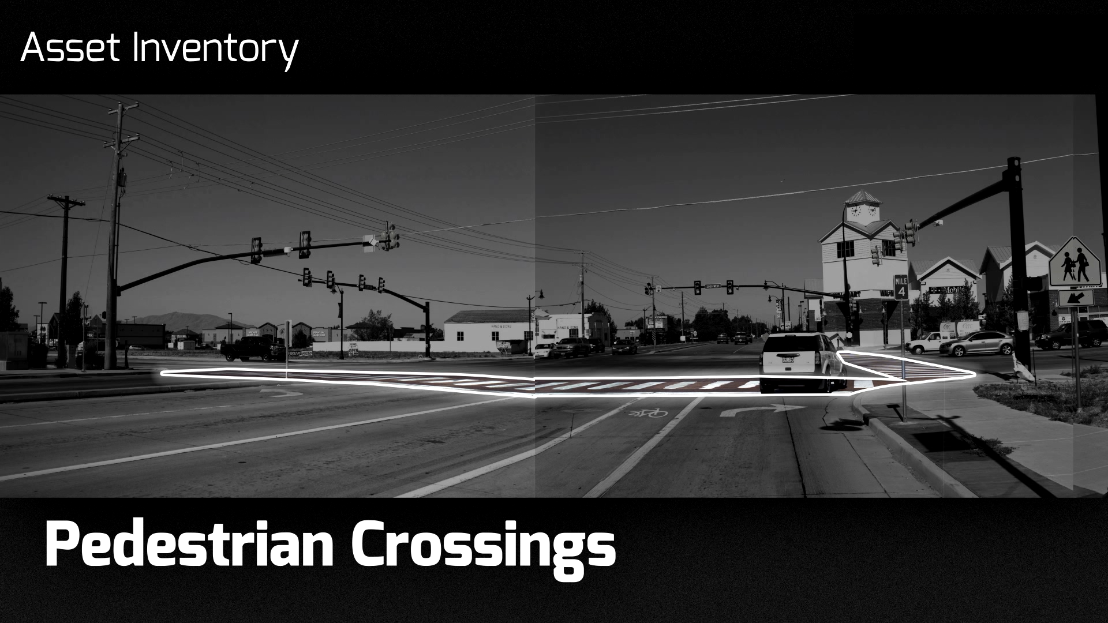

Slide 40
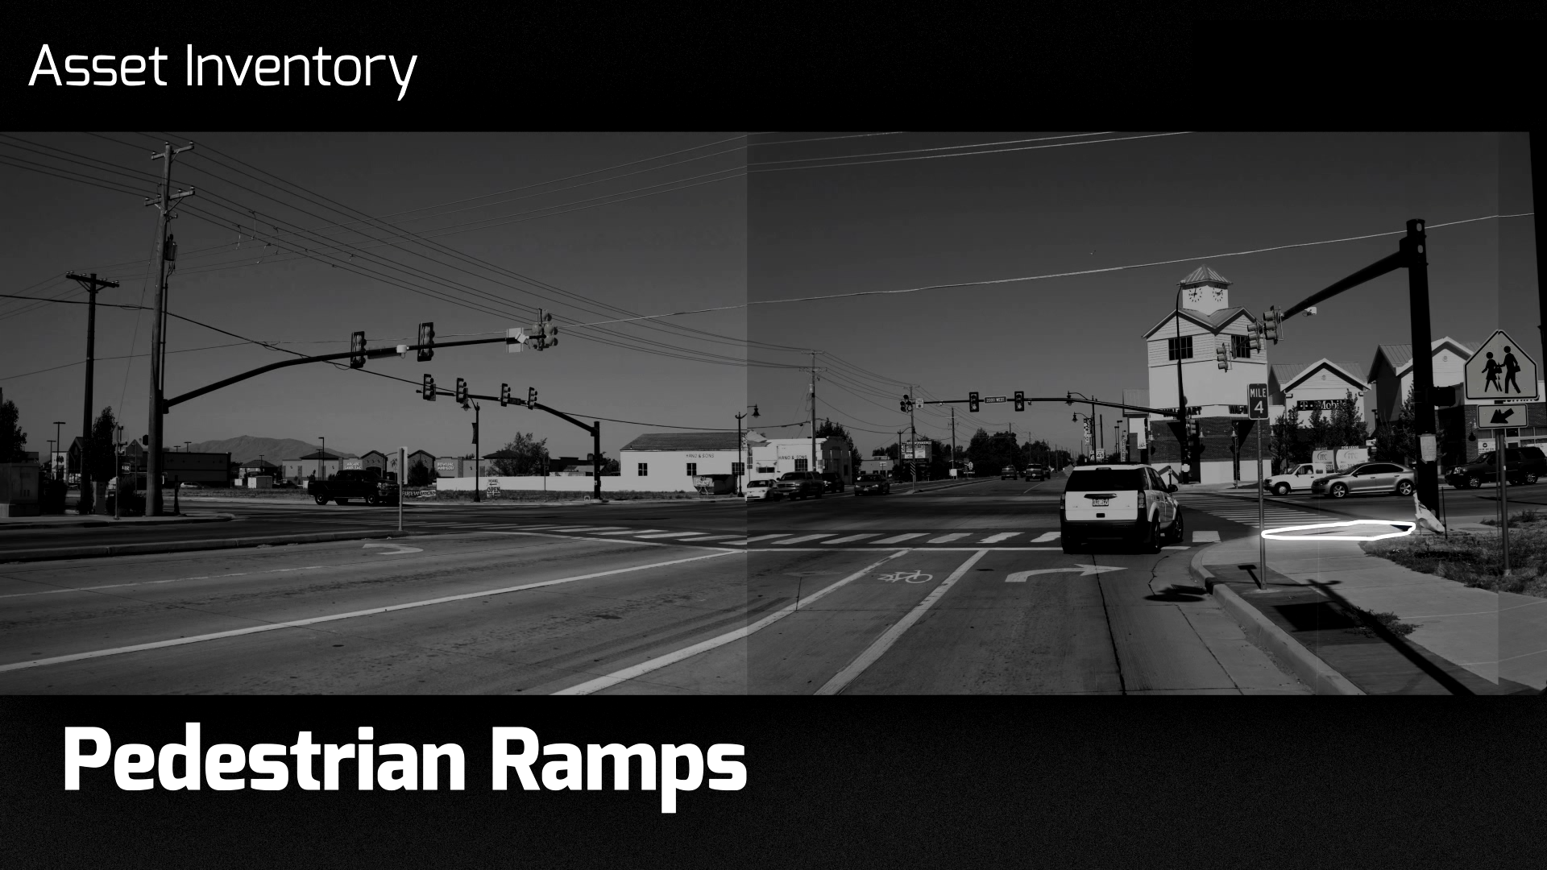

Slide 41
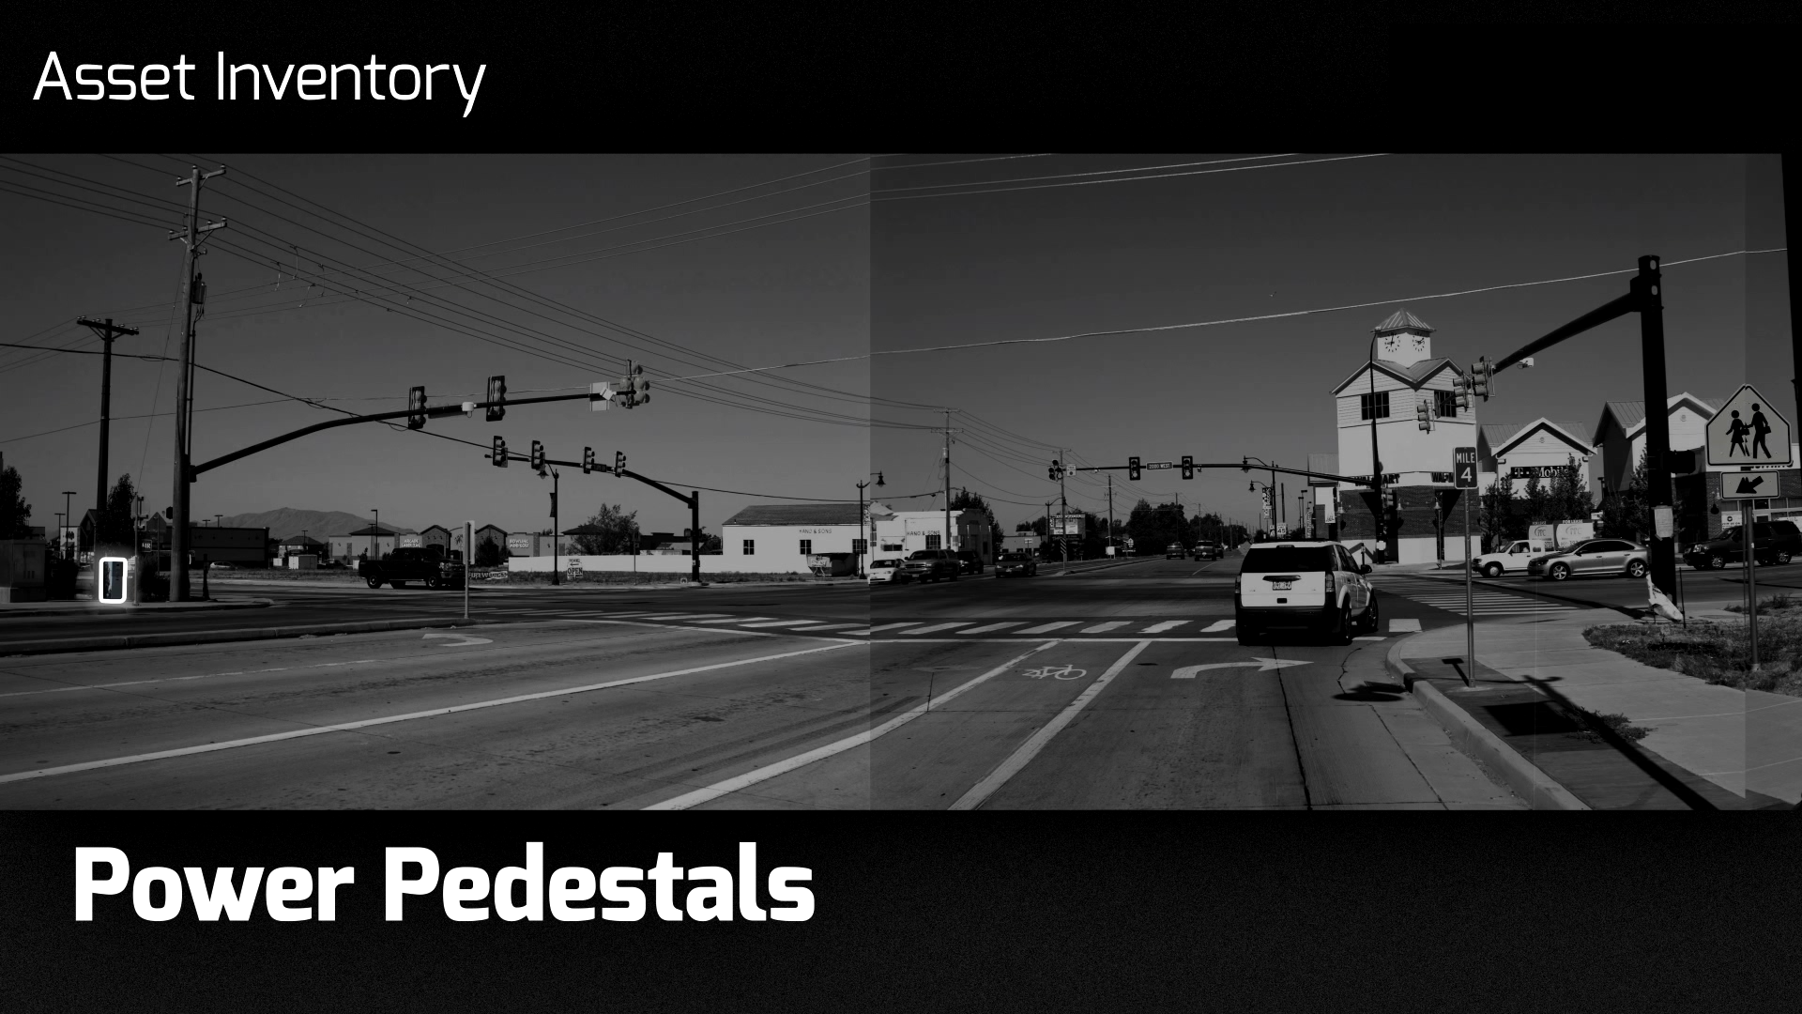

Slide 42
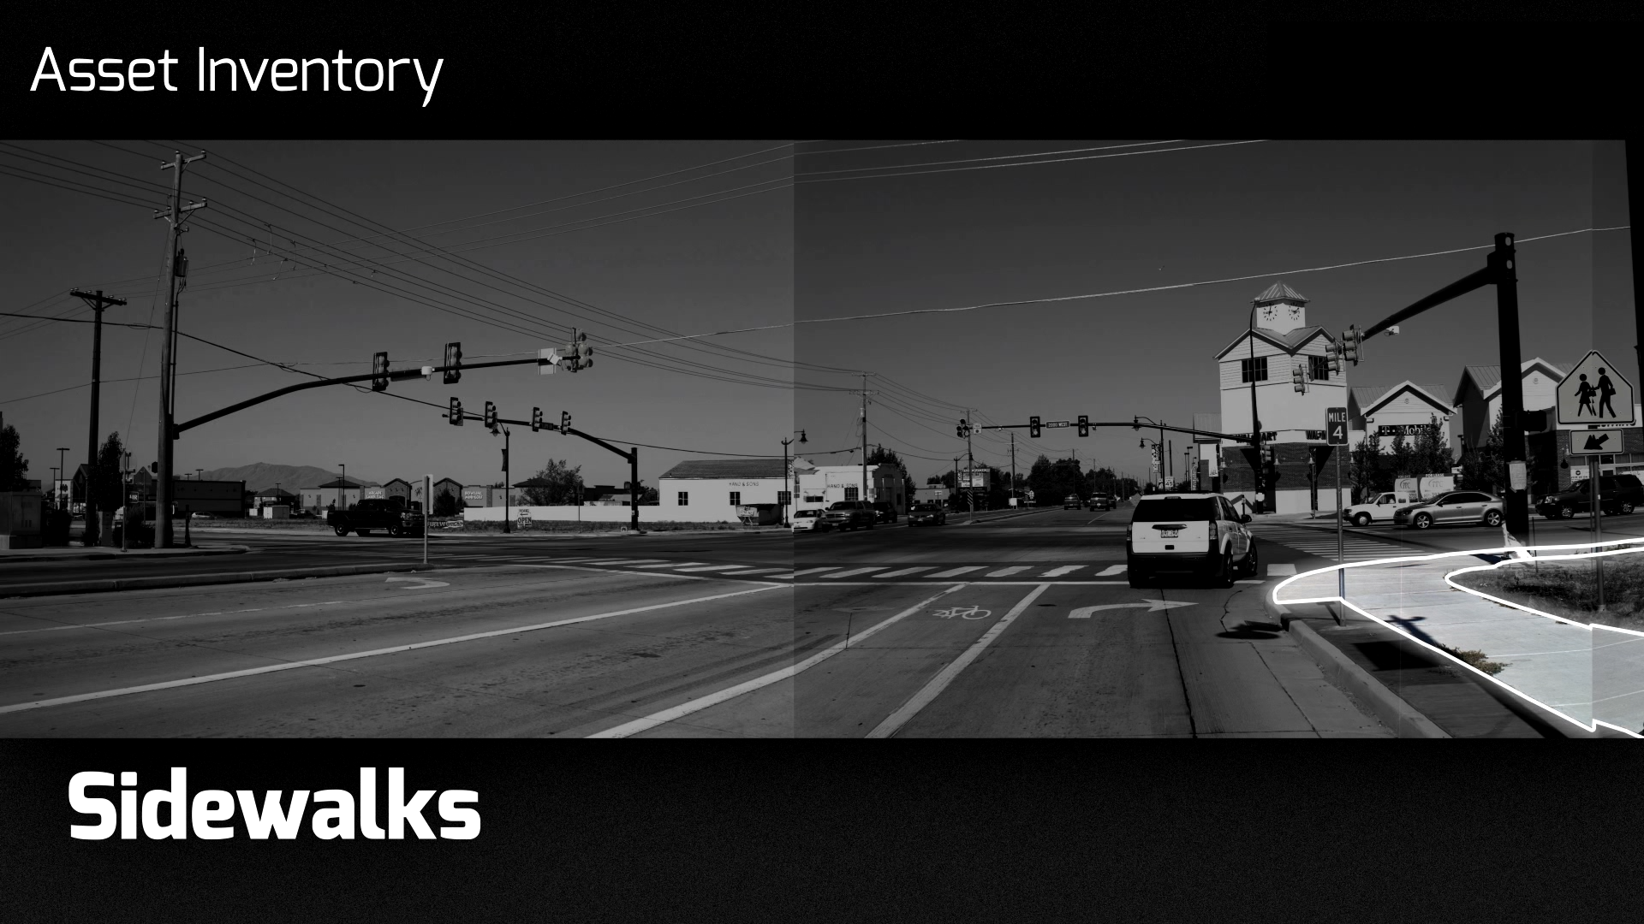

Slide 43
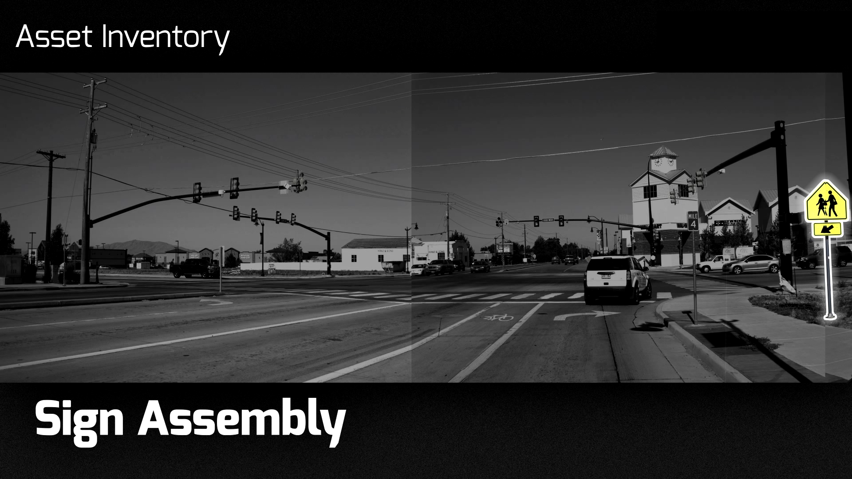

Slide 44
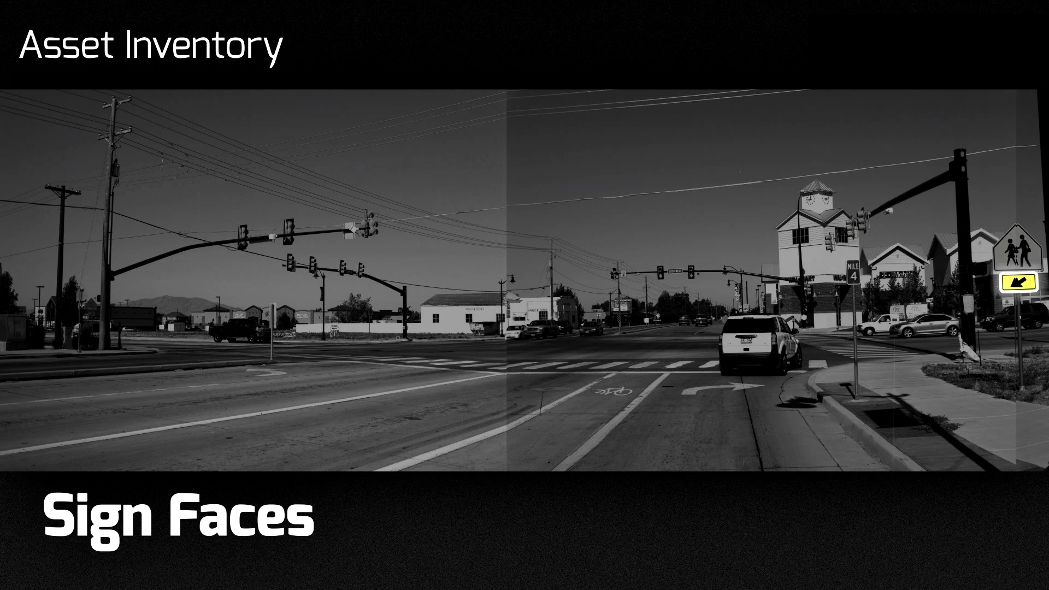

Slide 45
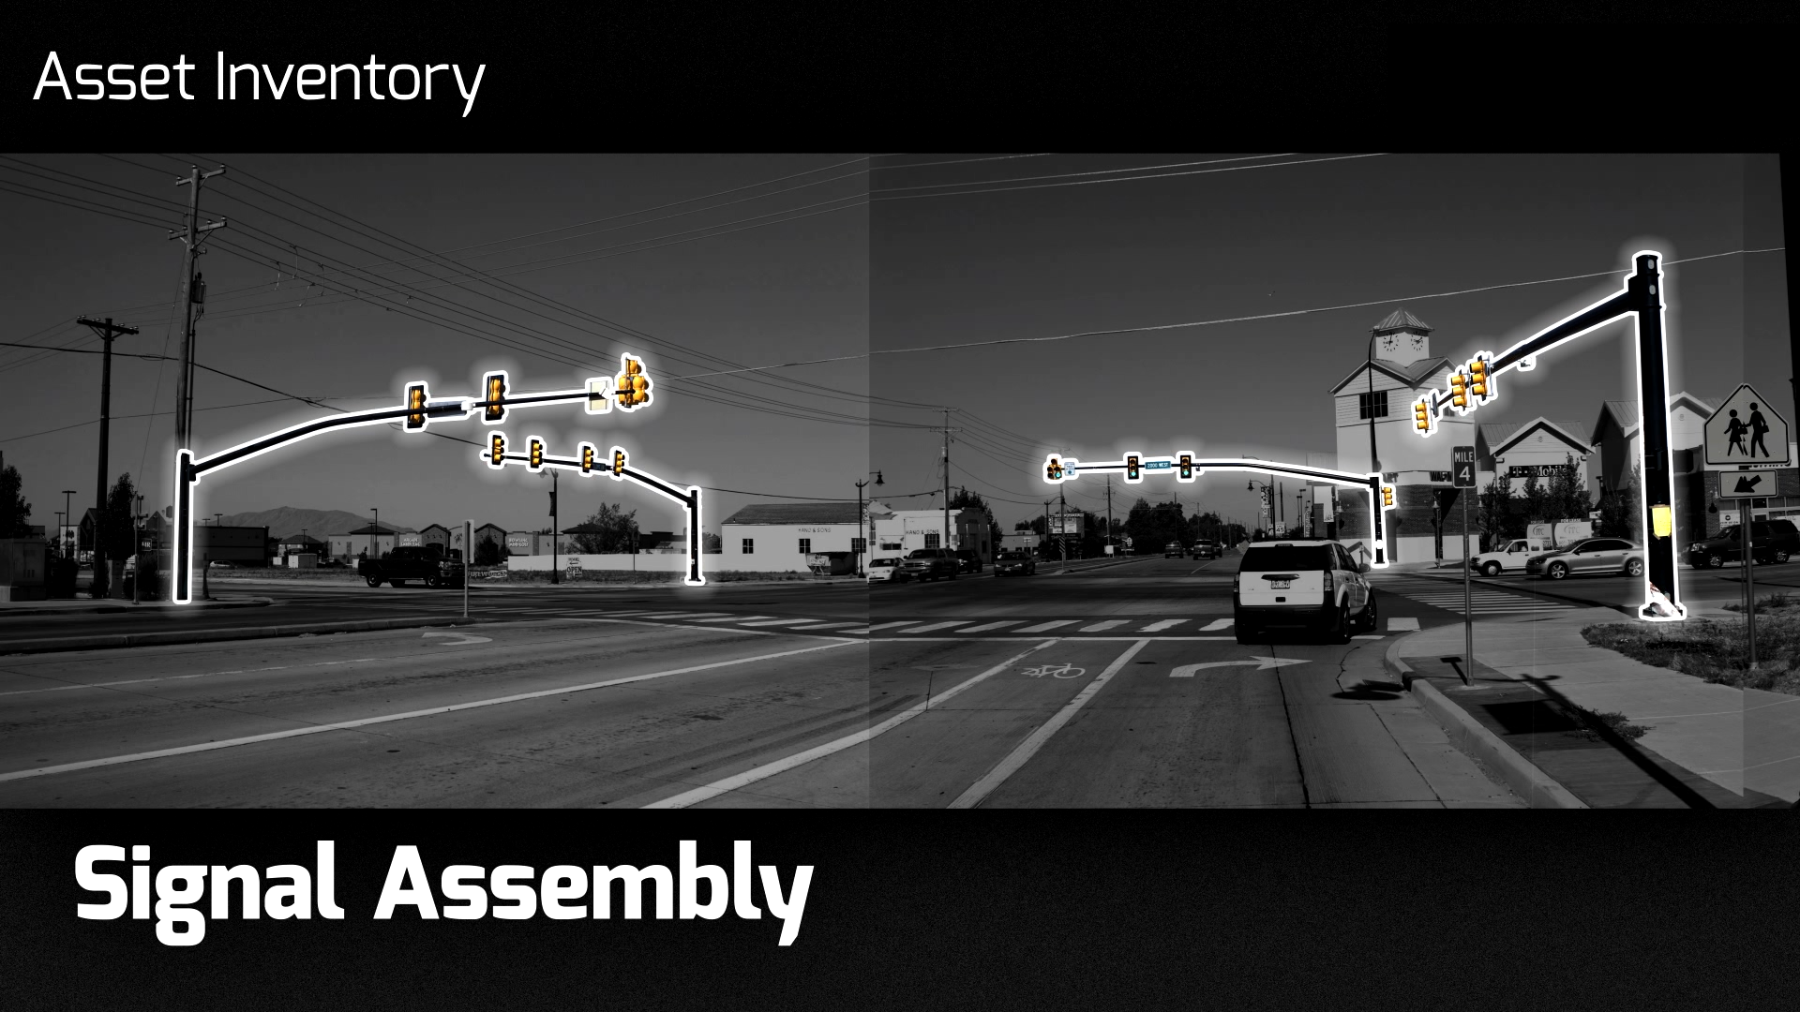

Slide 46
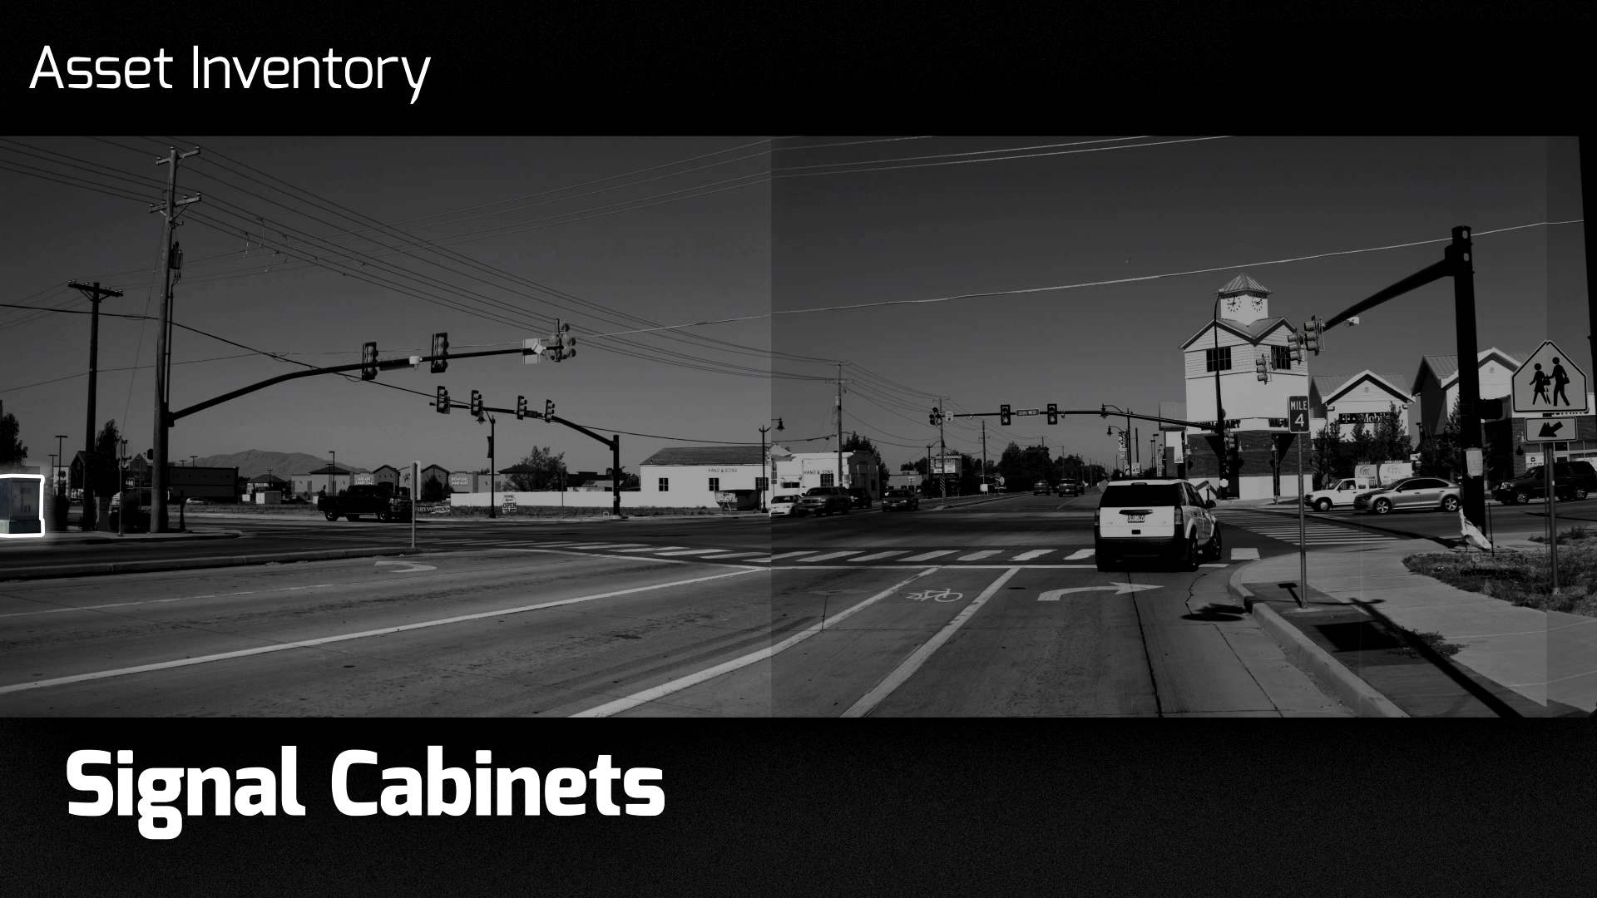

Slide 47
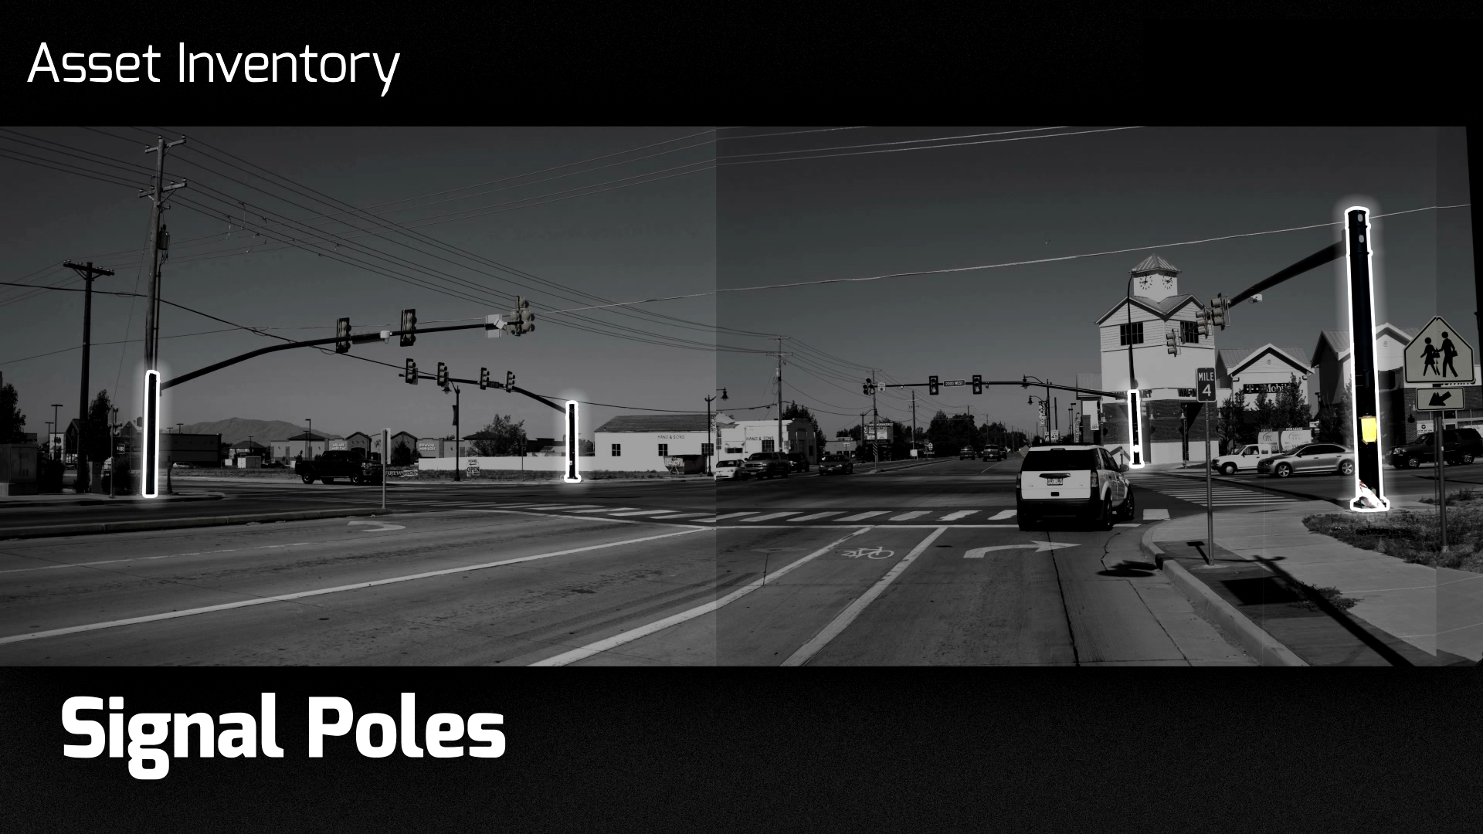

Slide 48
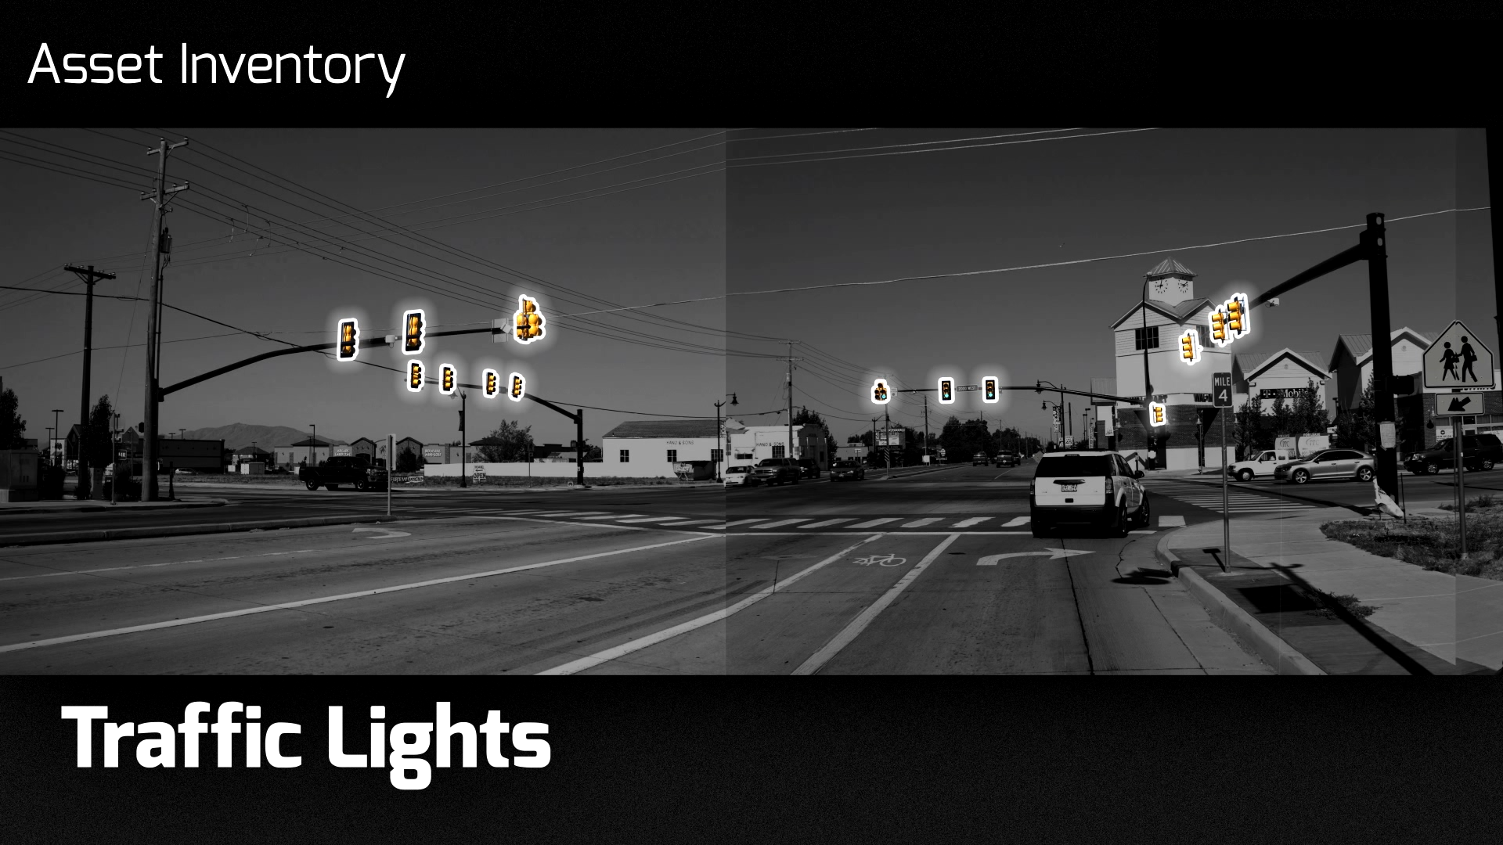

Slide 49
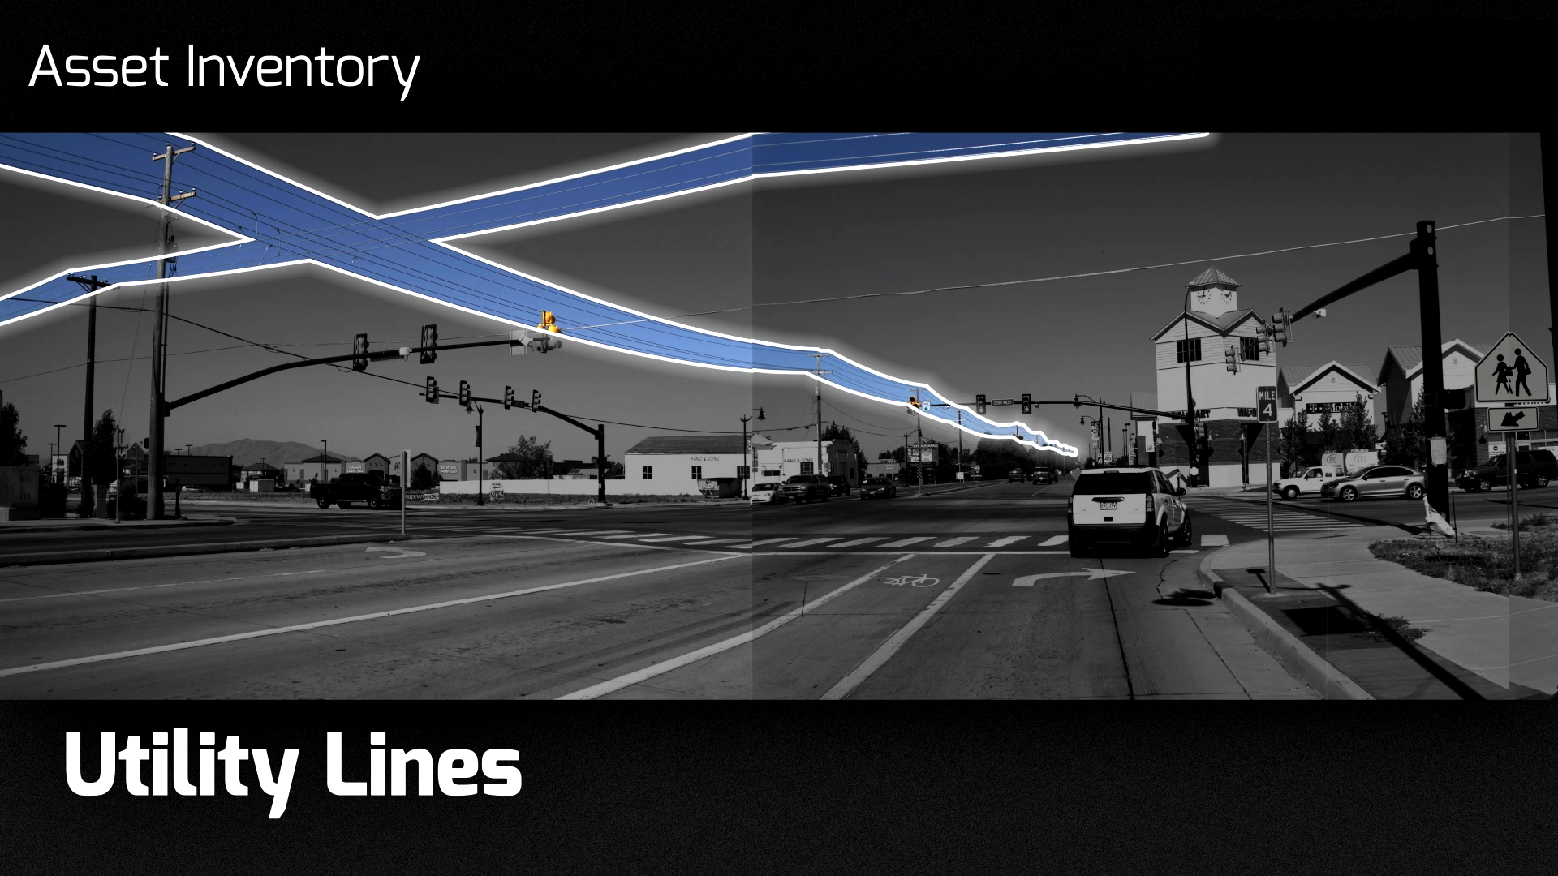

Slide 50
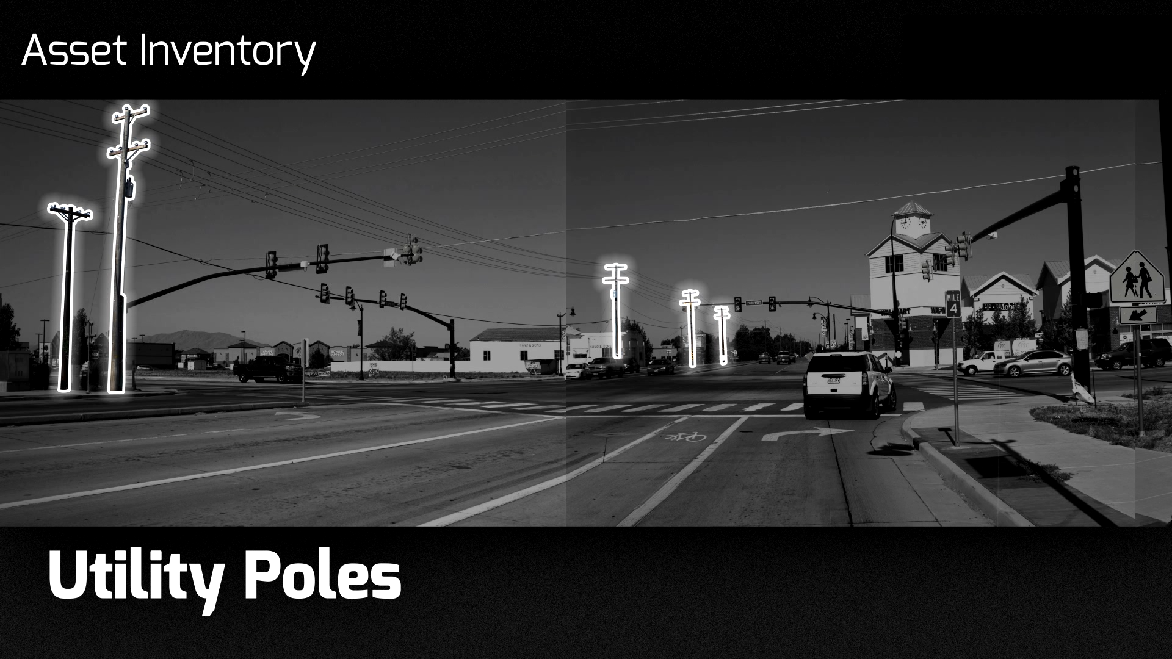

Slide 51
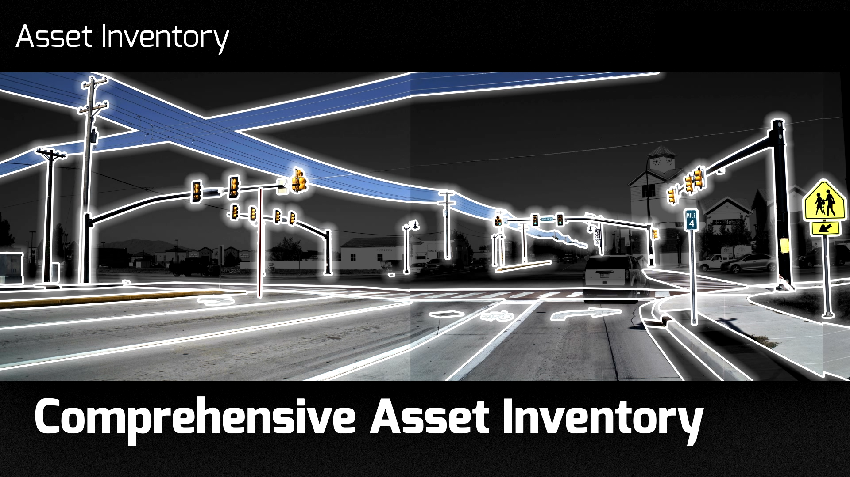

Slide 52
Mandli Communications, INC.
Thank You

